Slide 1
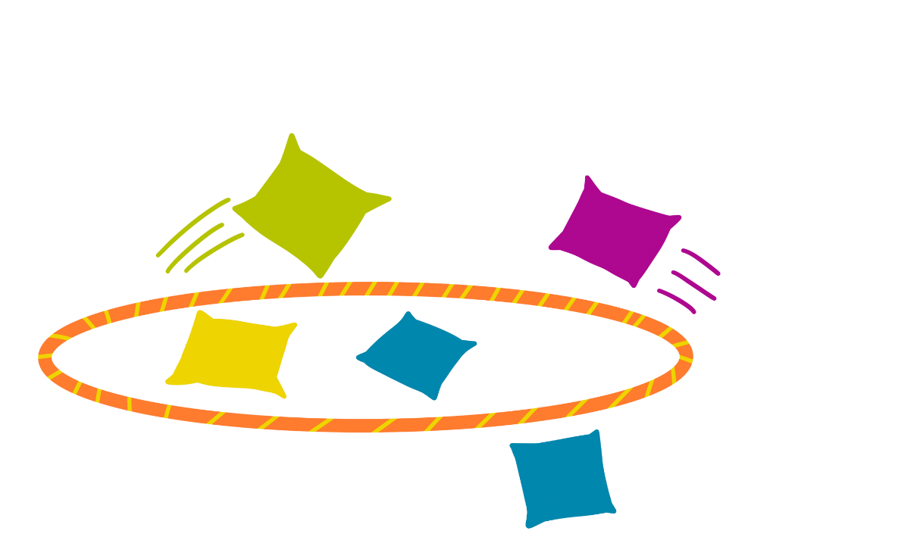
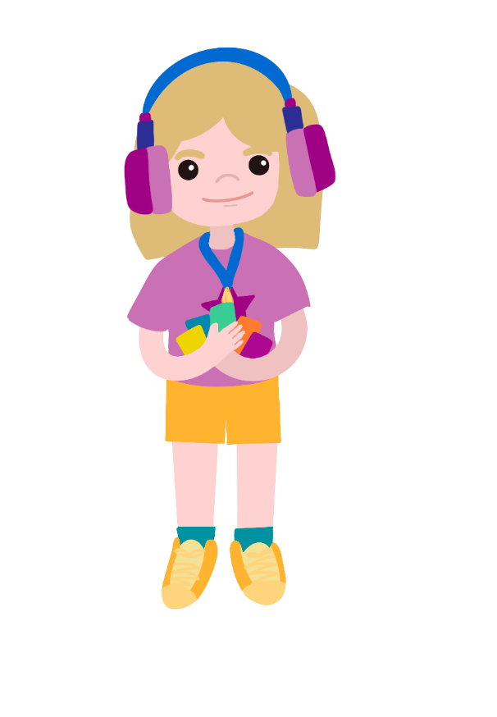
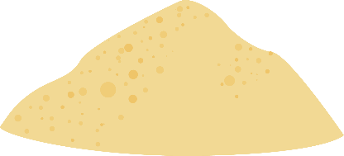
Testing Timers
Supported by:

Slide 2
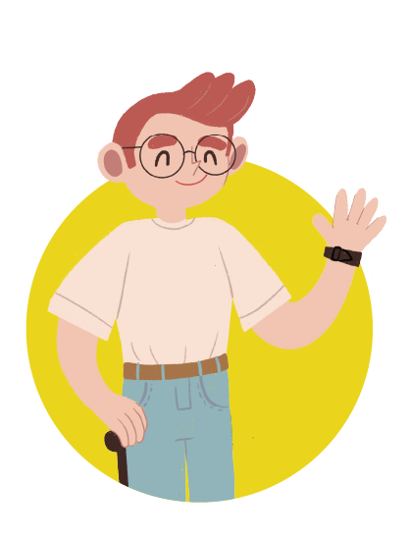
Meet the characters...
Uncle Astro
Uncle to Cosmic and Gem
Gem
Cosmic
Seren

Slide 3
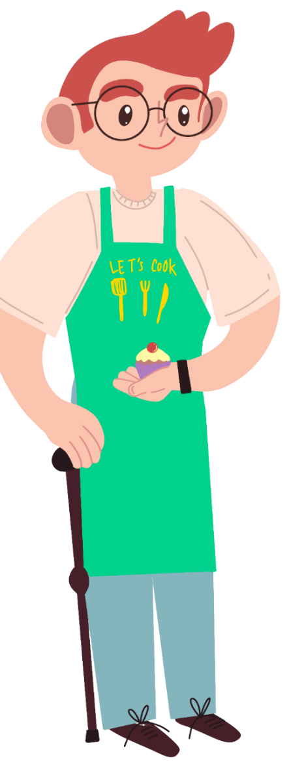
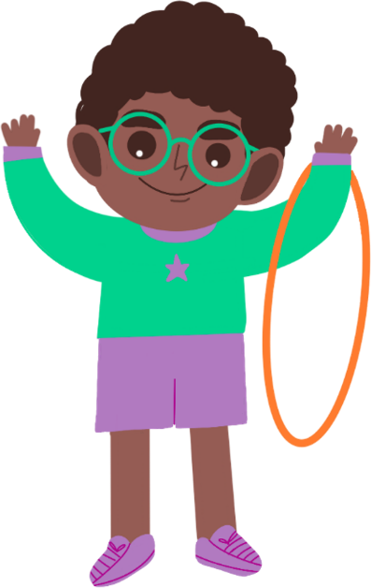
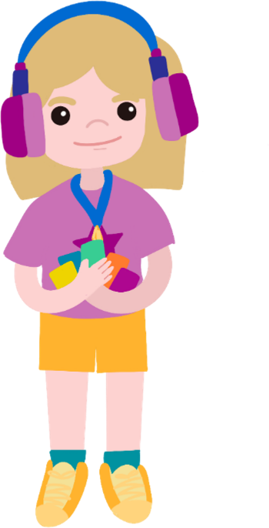
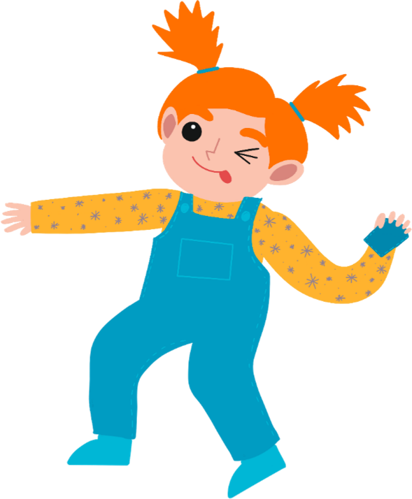
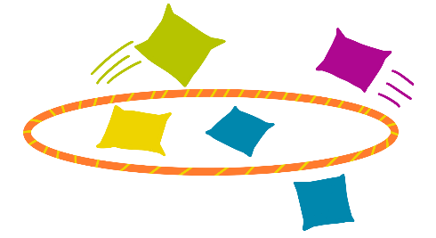
Cosmic, Gem and Seren are practising for Sports Day.
Off you go into the garden to practice, before something gets broken!
But we won’t be able to see a clock outside to time how many beanbags we can get in the hoop in a minute!

Slide 4
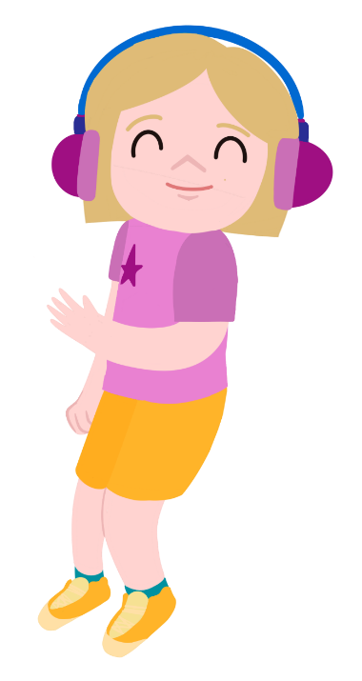
Why don’t you make your own sand timer to take outside?
What’s a sand timer and how does it work?

Slide 5
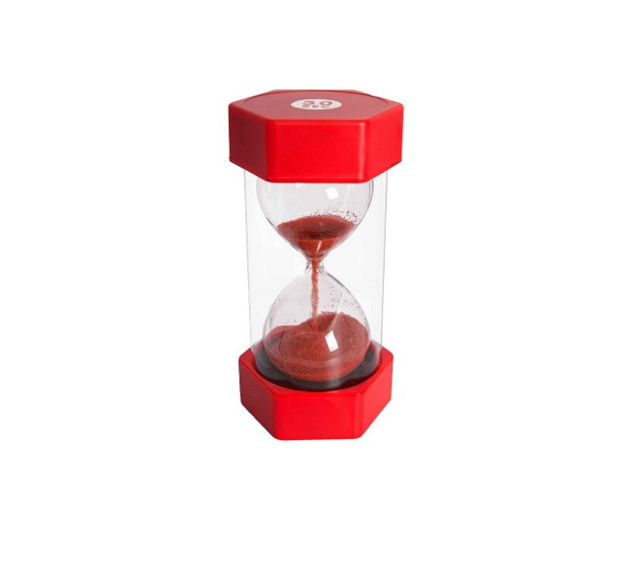
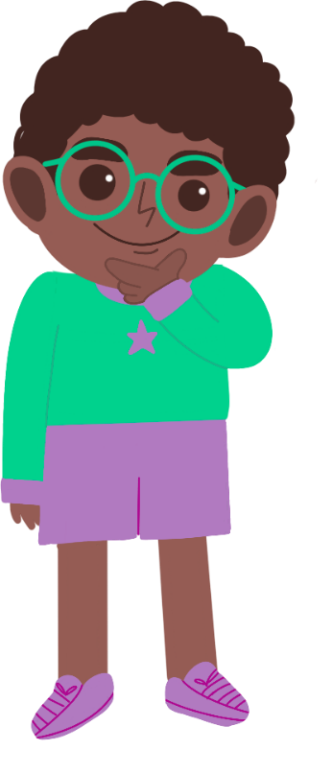
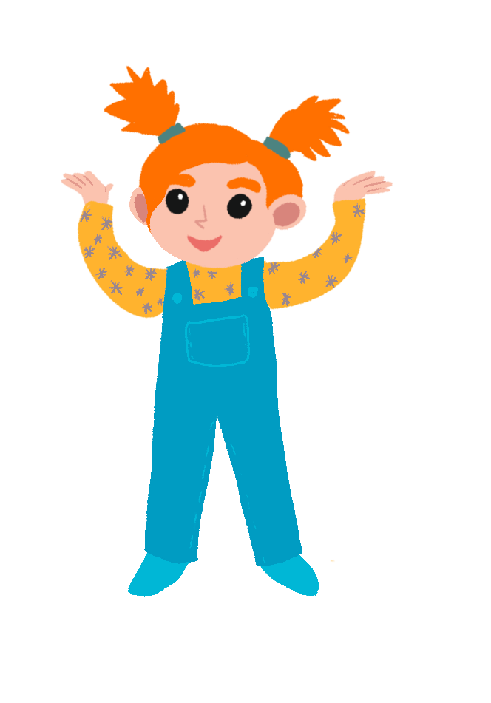
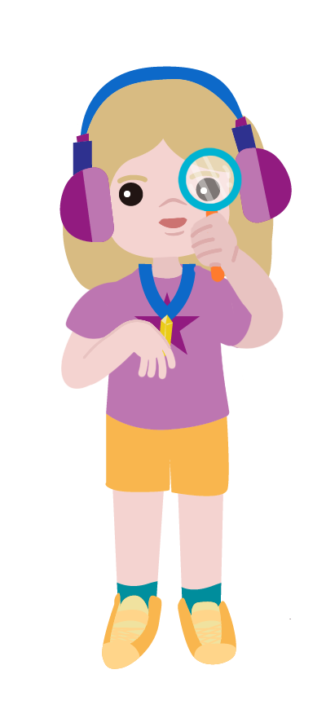
Have you ever seen a sand timer?
How do you think they work?

Slide 6
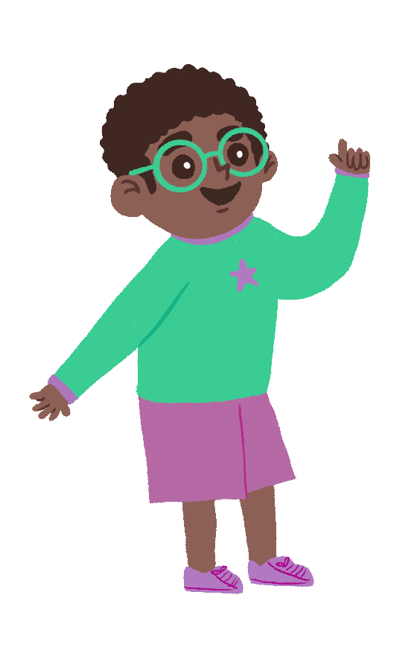
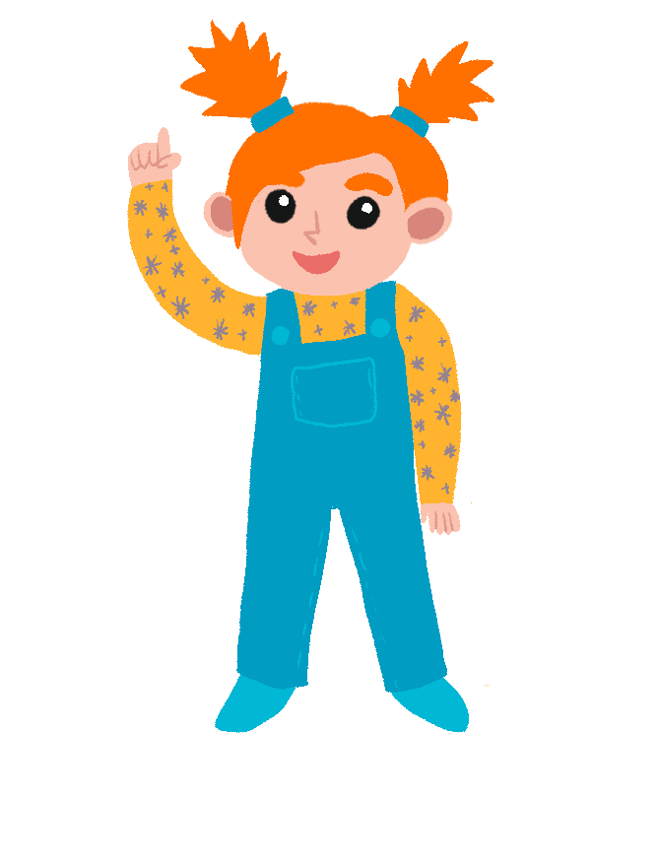
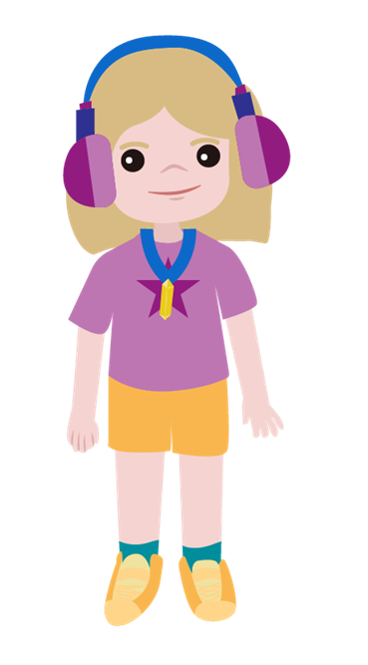
How can we make one?
I think it will depend on the size of the hole in the timer.
I think we'll only need a little bit of sand.
I think we'll need a lot of sand to measure one minute!

Slide 7
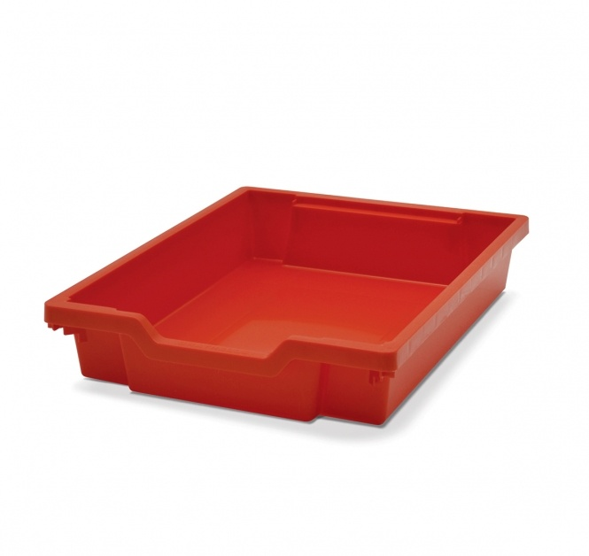
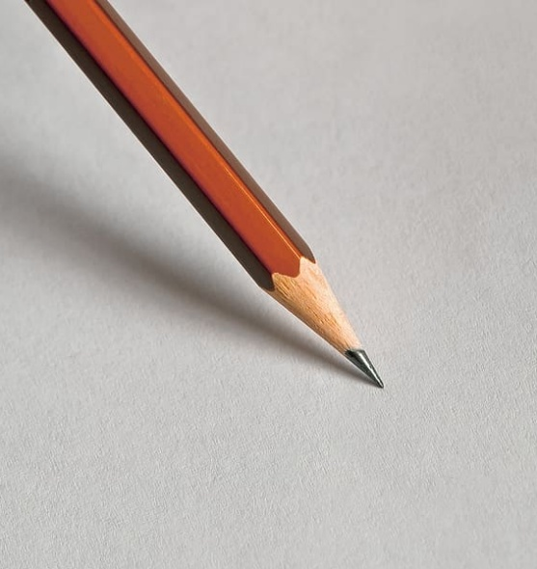
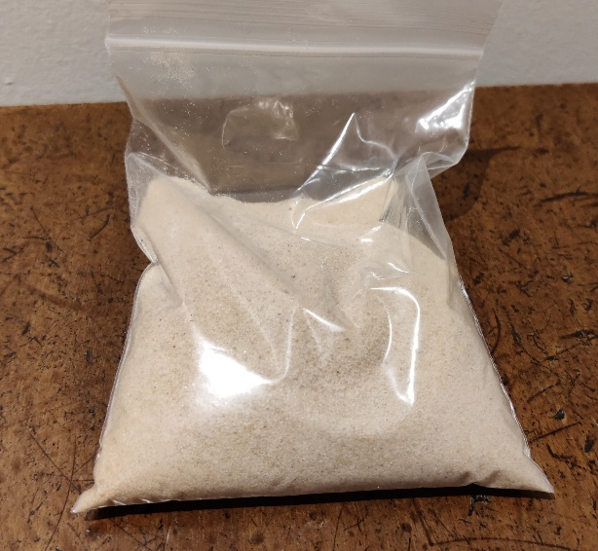
You are going to make your own sand timer!
cup
sand
pencil
tray

Slide 8
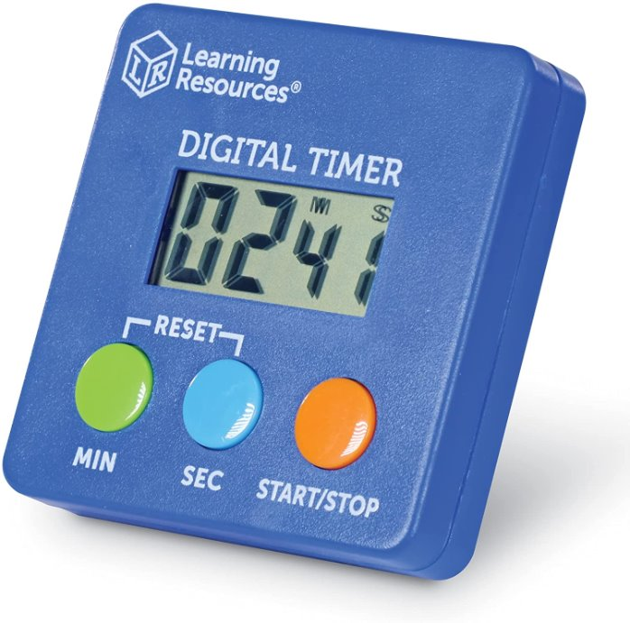
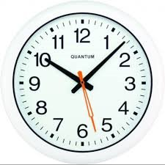
How long does your sand timer take?
Can you make your sand timer run for exactly one minute?
timer
clock

Slide 9
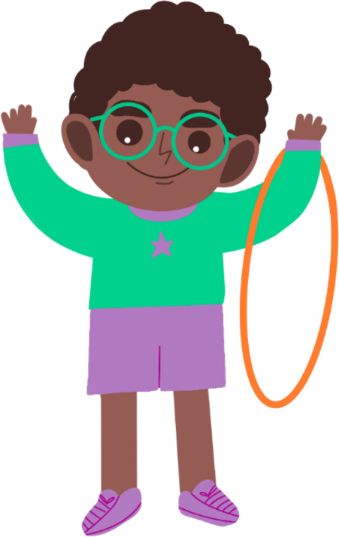
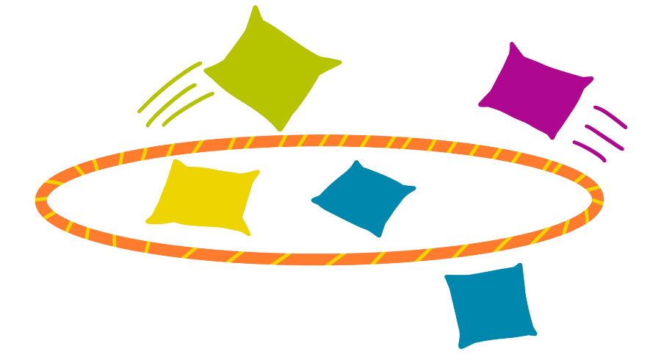
Recording your results
You could draw pictures, take photos or create a video showing how to make a sand timer.
Try using your sand timer to play the beanbag and hoop game with a friend!

Slide 10
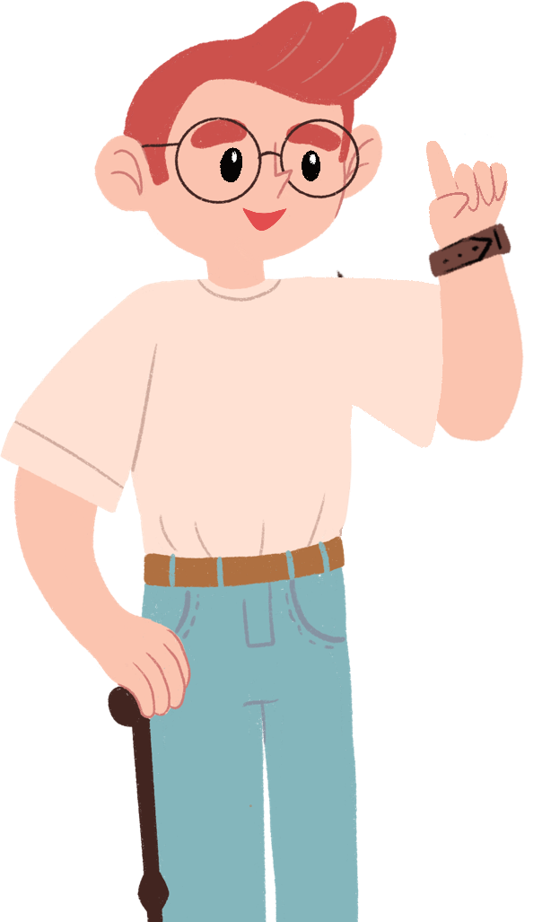
Taking it further...
Try putting more holes in your sand timer and see what happens!
What else could you use to make a timer?

Slide 11
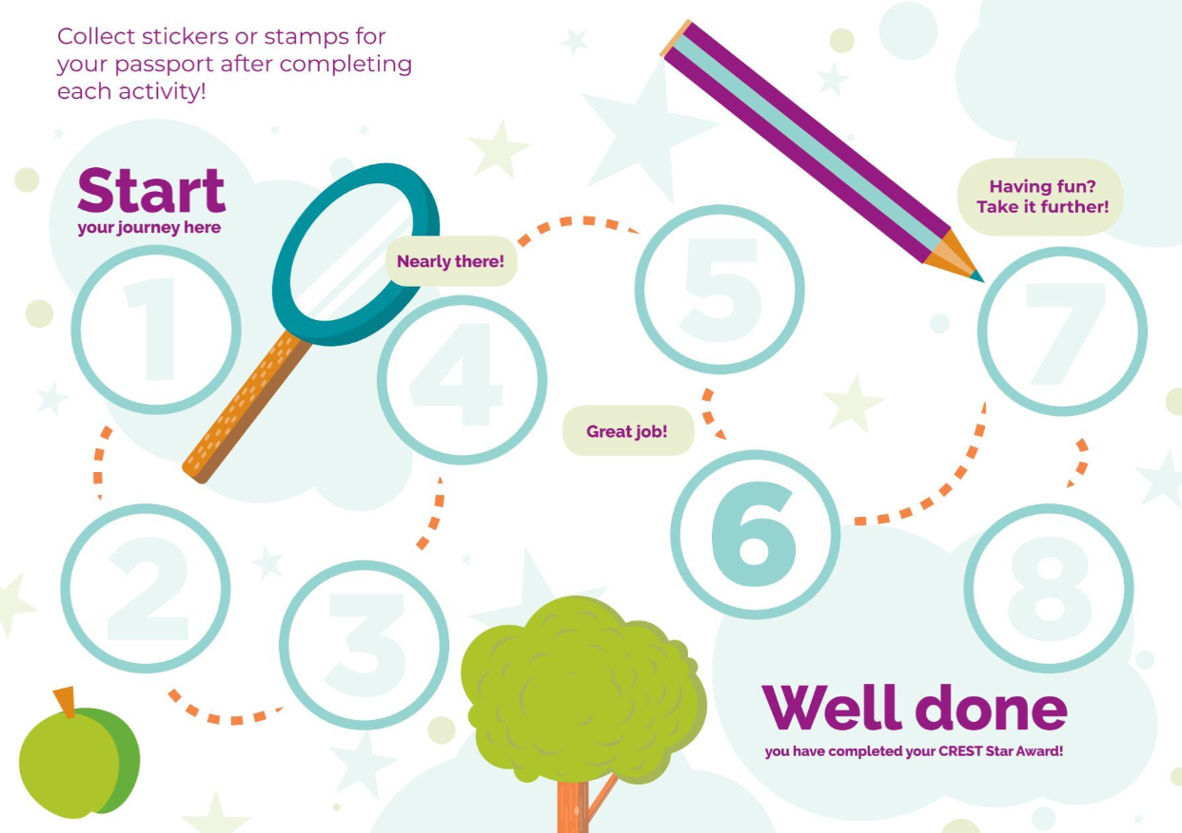
Well done!
You can add a stamp or sticker to your CREST Passport!

