Slide 1















Be Seen, Be Safe
Organiser’s card:
About the activity
This activity is designed to get children thinking about reflection and light. The activity works best when run with small groups.
Kit list
You could ask children in advance to bring things in that they think will help them to
be seen in the dark.
Tara wants to join Zeke and take Luna the dog out for a walk, but it’s starting to get dark. The children are asked to help Tara and Zeke decide on the best thing to wear that will help them be seen in the dark.
A selection of different materials, e.g. different coloured t-shirts or fabrics, reflector armbands, mirrored card, dark/light coloured paper etc.
Through this activity you will support your group to:
Test different materials to see how reflective they are.
Record and share their results.
Torches
What to do
A place that can be partially blacked out, e.g. use a dark coloured tablecloth over a table to create a dark den.
1. Introduce the activity using the story on the accompanying slides or activity card. Ask the children what they think will help them to be seen in the dark. Show the equipment to the children.
Explain that they will be using the equipment provided to test the best way to be seen in the dark.
Encourage children to discuss their ideas about how to carry out their investigations. Prompt questions could include:
  Which materials do you think will be seen?
  How will you test to see if the materials are reflective?
  How will you record your results?
Support children to conduct their tests and make their own records of their results. They could sort the materials or order them from least to most effective reflector.
Ask the children to share their findings with the rest of the group – they can be as creative in their presentation as they want.

Slide 2











Things to think about
Key words
Some things produce light, e.g. a lamp, the Sun. We call these light sources. Other things can reflect light, but they don’t produce light of their own, e.g. a mirror, aluminium foil, a white t-shirt. We call these reflectors. Some colours reflect more light than others. White is easier to see than red; red is easier to see than black.
Light
Dark
Shiny
Safety
Reflection
Source
Reflectors will be seen if there is a source of light. Even on a ‘dark’ night, there is usually light around, especially in towns. A good reflector may be visible on a dark night because of this. Cat’s eyes and reflective strips will also reflect the lights of cars. So Tara and Zeke will need to wear something light coloured or shiny to be safe in the dark.
Watch out!
Make sure that children are not wandering around in the dark with sharp objects.
Make sure that the area is cleared of
obstacles and dangerous substances.
Explain that children should not stare directly at bright light sources.
British Science Association Registered Charity No. 212479 and SC039236

Slide 3


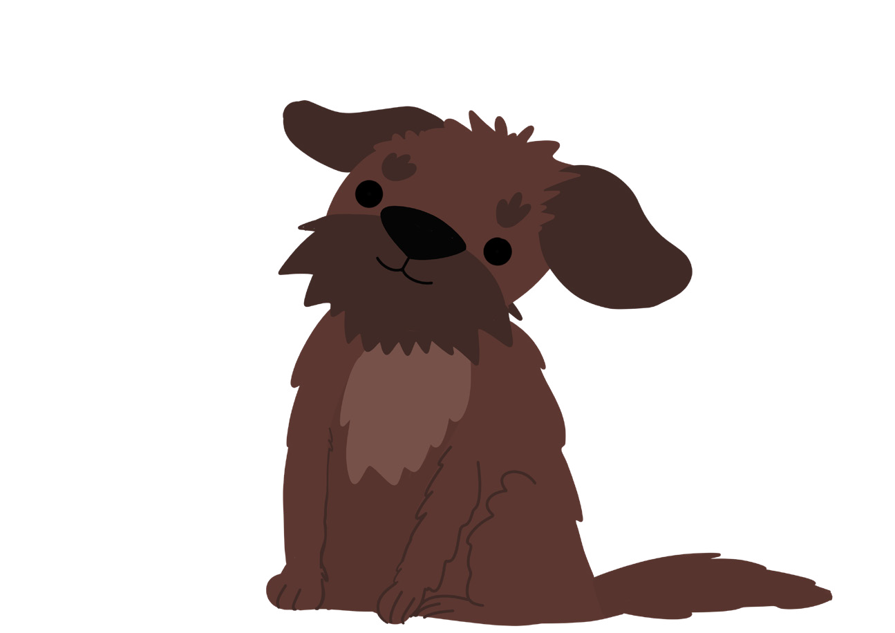






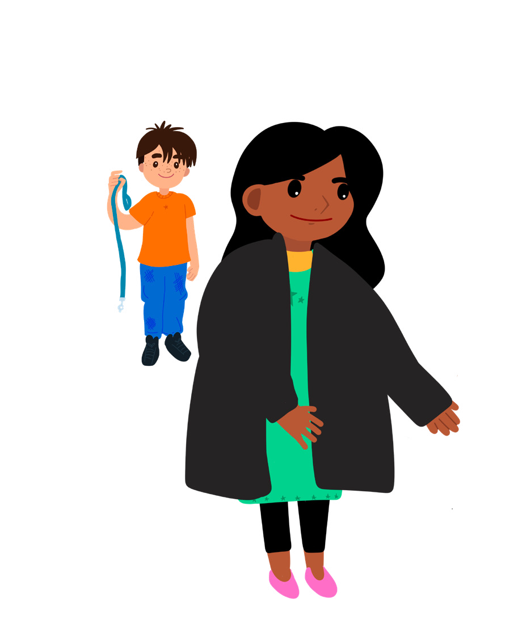

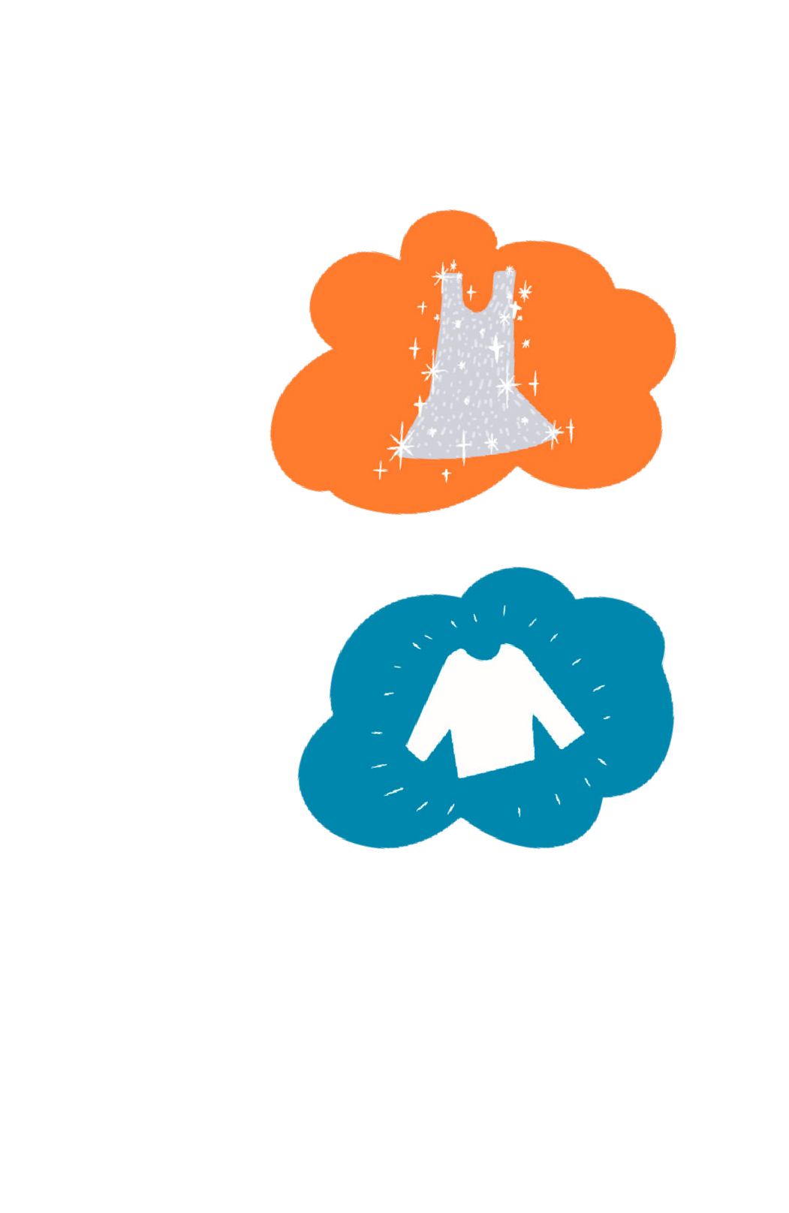



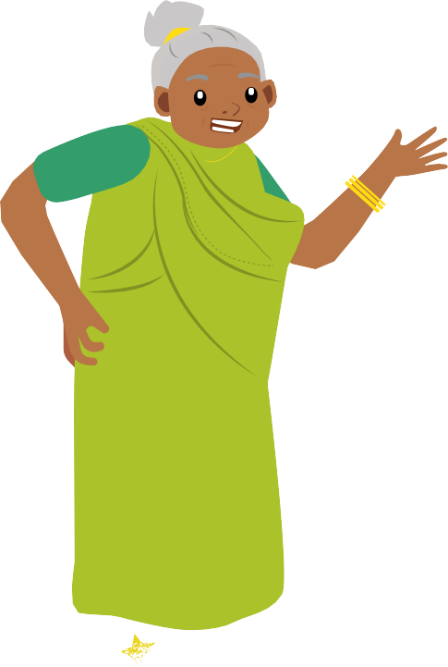



Be Seen, Be Safe
Luna
Activity card:
Tara is really excited as she’s going to meet Zeke’s new dog, Luna, and help take her out for a late afternoon walk. Joyti, Tara’s grandmother, is coming too, but when she sees Tara putting on her black coat, she shakes her head.
“Hold on,” says Joyti, “it’s going to start getting dark soon, you can’t go out in those clothes, it’s not safe!”
“What do you mean?” asks Tara.
“That black coat you’re wearing won’t be seen once it’s dark,” explains Joyti. “Let’s find you something that will keep you seen and safe!”
Zeke
Your challenge
Find out if Tara and Zeke can wear something that will help them to be better seen in the dark.
Tara thinks they need to wear something shiny.
Zeke doesn’t think what they wear makes a difference.
Joyti thinks they need to wear something white.
What do you think?
Tara
Joyti

Slide 4










Why do you think Tara’s black coat might not be seen at night?
Have you noticed what you can see in the dark?
How will you find out if different materials can be
seen in the dark?
Discuss
Getting started
You need to compare how well each material can be seen. Make a dark space. You could draw the curtains, work in a tent or cupboard, or use black fabric to make a den. This will help you see the difference between good and bad light reflectors.
Which materials can you see the best?
What difference does having more light make? What can you see in complete darkness?
Do some colours work better than others?
Test your ideas
You could test the different materials and then put them in order from the most difficult to see in the dark, to the easiest to see in the dark. Take a photo and compare your order to other people’s. Are they different or the same?
Which material would keep Tara and Zeke the safest as it starts to get dark outside?
Share your ideas
Extra things to do
How did your investigation go?
Was there anything you could have improved about your test?
Why not design something for Tara, Zeke or Luna to wear?
Find out if you can see
reflectors in total darkness.
Design a warning poster to help children be safe at night.
British Science Association Registered Charity No. 212479 and SC039236

