Slide 1
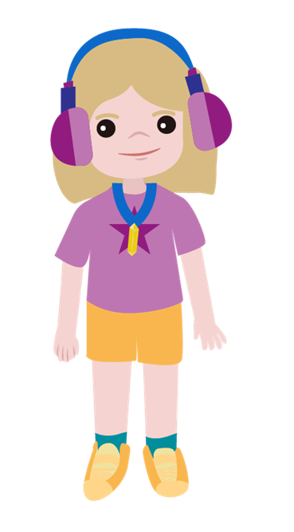
Sneaky Shadow
Supported by:

Slide 2
Meet the characters...
Seren
Aunt Stella
Auntie to Cosmic and Gem
Gem

Slide 3
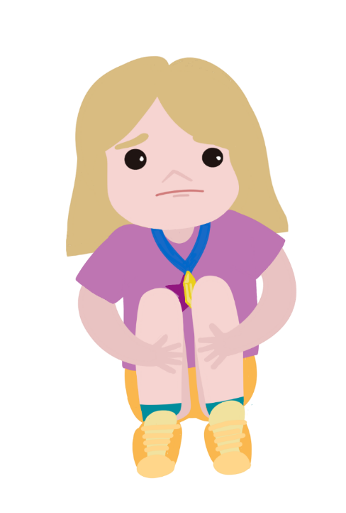
Seren is worried.
I've lost my shadow. It was there when I was outside playing. It was there when I walked home from school. Now it's gone.
Seren goes to Gem's house.
Maybe they can find her shadow in the garden.

Slide 4
It is getting dark outside.
I can help you find your sneaky shadow with this torch!
It was under the outside light, but it disappeared when it went off!

Slide 5
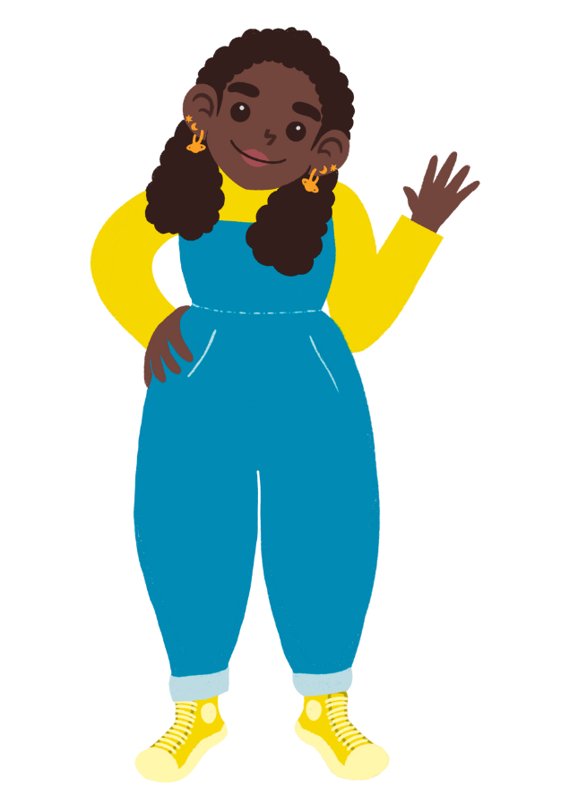
What makes a shadow?
I think you will see your shadow if there is bright light.
I think you can only see your shadow when the sun is shining.
I think shadows hide when it goes dark.

Slide 6
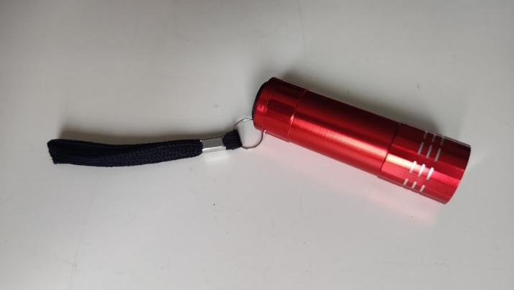
How can you find out?
torch

Slide 7
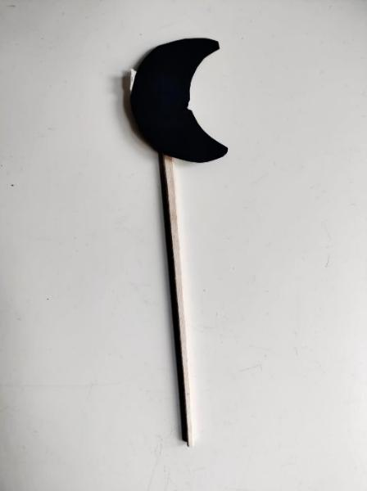
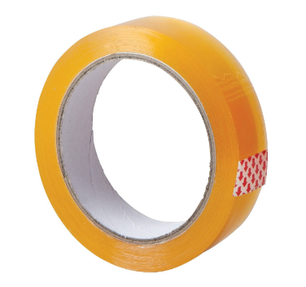
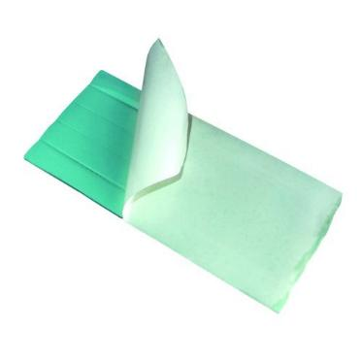
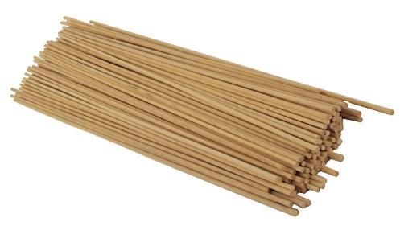
Make a shadow puppet

Slide 8
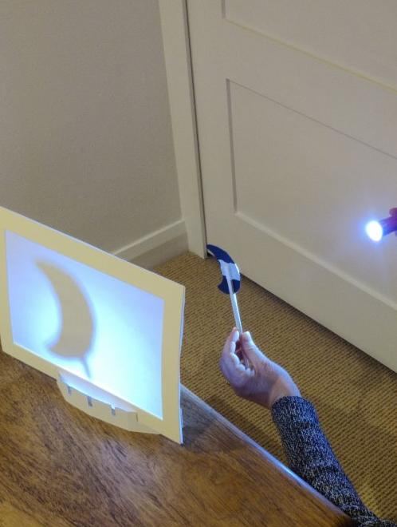
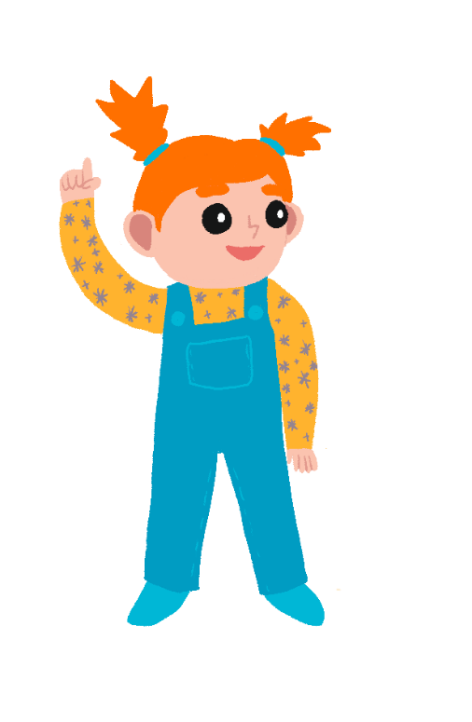
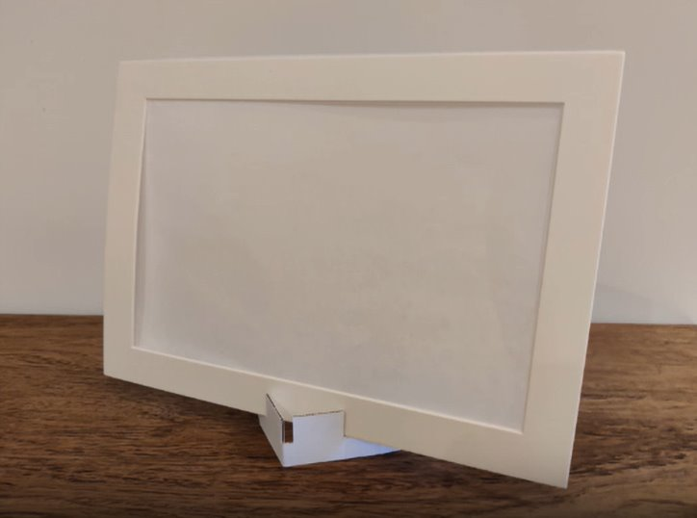
Recording your results
Can you explain how to make a shadow?
Use your puppet to make and share a shadow play!
You could try setting up a little shadow puppet theatre!

Slide 9
Who do you agree with?
I think you will see your shadow if there is bright light.
I think you can only see your shadow when the sun is shining.
I think shadows hide when it goes dark.

Slide 10
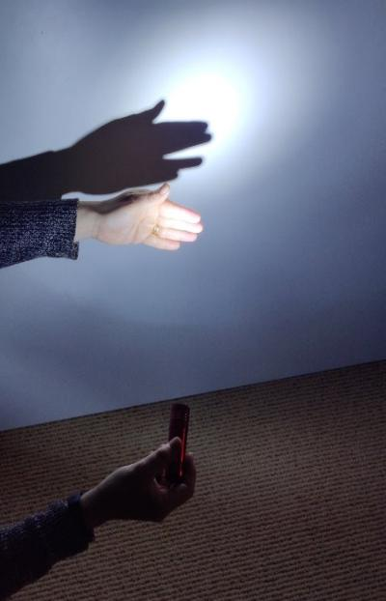
Take it further...
Can you make the size of a shadow change?
Is it possible to make a coloured shadow?

Slide 11
Well done!
You can add a stamp or sticker to your CREST Passport!

