Slide 1
















Plant Detectives
Organiser’s card:
About the activity
This activity is designed to get children thinking about where plants grow. You could run the activity with small groups, or with a whole class.
Kit list
Access to a safe outdoor environment, ideally with a variety of surfaces such as brick walls, paving, concrete, grass
Zeke has found a plant growing out of the pavement. He can’t work out how it got there. Plants grow in gardens, not pavements – don’t they? Zeke and Tara need to be plant detectives and look for clues! But where should they look to solve the mystery?
Appropriate magnifiers,
e.g. magnifying glasses
Through this activity you will support your group to:
Think about where plants grow.
Cameras/tablets, drawing equipment, or stickers and a simple map of your outdoor environment
Investigate and discover plants in their surroundings.
Record their results using photos, drawings or a map.
What to do
Key words
1. Introduce the activity using the story on the accompanying slides or activity card. Get the children to talk to each other about the questions and the opinions of Zeke and Tara.
Grow
Leaves
Flowers
Soil
Plants
Seeds
Samples
Map
2. Talk with the children about where they can search for plants. Encourage them to think of unusual places to look.
3. Discuss with the children how they will record their findings
and make sure everyone stays safe.
Children can collect samples, take photographs or create drawings. If you provide a map or plan of the area, they
can add stickers or images to record where plants were found. Confident children may be able to make their own maps or plans.
Warn children not to eat any part of the plants that they find.
When the children finish hunting, let them share what they
have discovered.
There are extra things to do on the activity card for children
who have finished or who want to do more finding out at home.

Slide 2












Things to think about
Watch out!
The plants that are found during the hunt will vary depending on the time of year. You can repeat this activity in different seasons and find out how the plants change.
Follow your organisation’s guidelines for outdoor work. Children should be supervised at all times –
levels of supervision will vary depending on the location and the age of the children.
Most children will think that plants need to be planted in soil to grow. They may not be aware that plants (including tree seedlings) can grow in many places where there is little or no soil – for example, between bricks and paving stones, on walls, in gutters, in cracks in the bark of trees and in water. Some plants are adapted to survive in difficult conditions. For example, rosebay willowherb and poppy are plants that grow readily in very sparse conditions.
All children should be made aware of the boundaries of the investigation area.
Common outdoor allergens include plants, animals, pollen and stings. Check school records beforehand to see whether any of
the children have severe allergies to these.
Take it further
If you have a tablet or a mobile phone, you could try using Google Lens or a similar app to identify the plants that the children find.
Children should be reminded not to put their fingers in their mouth, nose or eyes.
During the plant hunt the children may also find lichen and fungi.
These are not actually plants, but they are living.
Children must not put any plants in their mouths.
Ensure they wash their hands
when they have finished.
The CLEAPSS website offers more guidance on working safely outdoors,
refer to Guide P094 for more information
British Science Association Registered Charity No. 212479 and SC039236

Slide 3

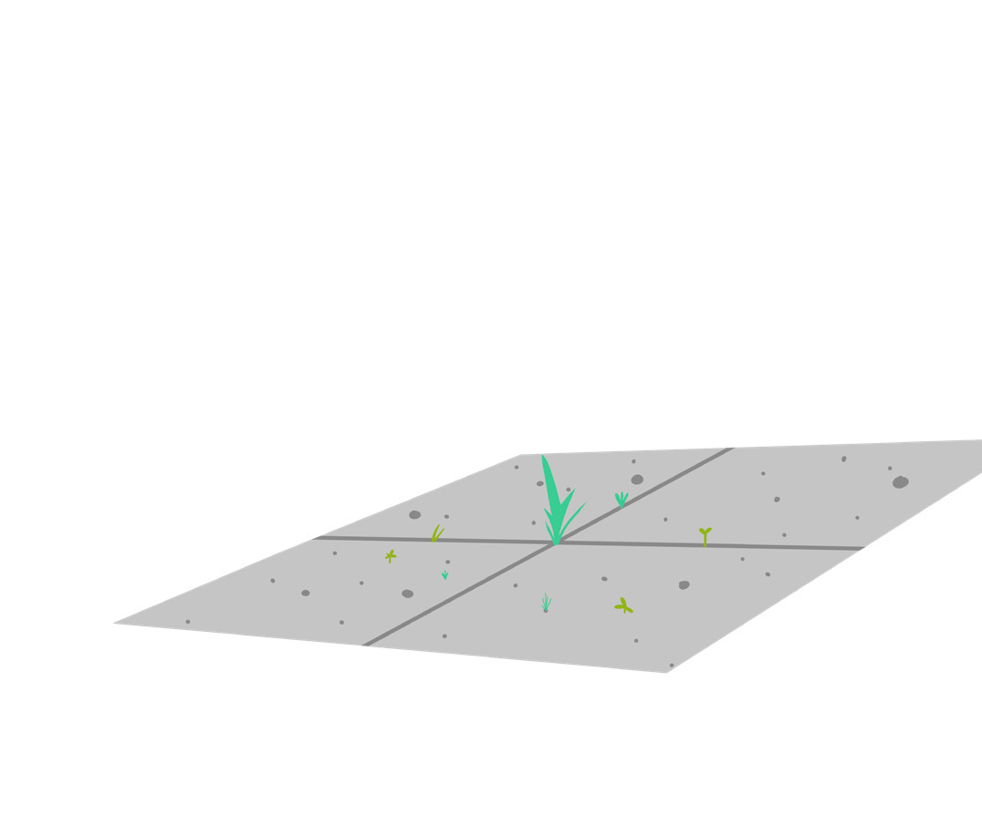



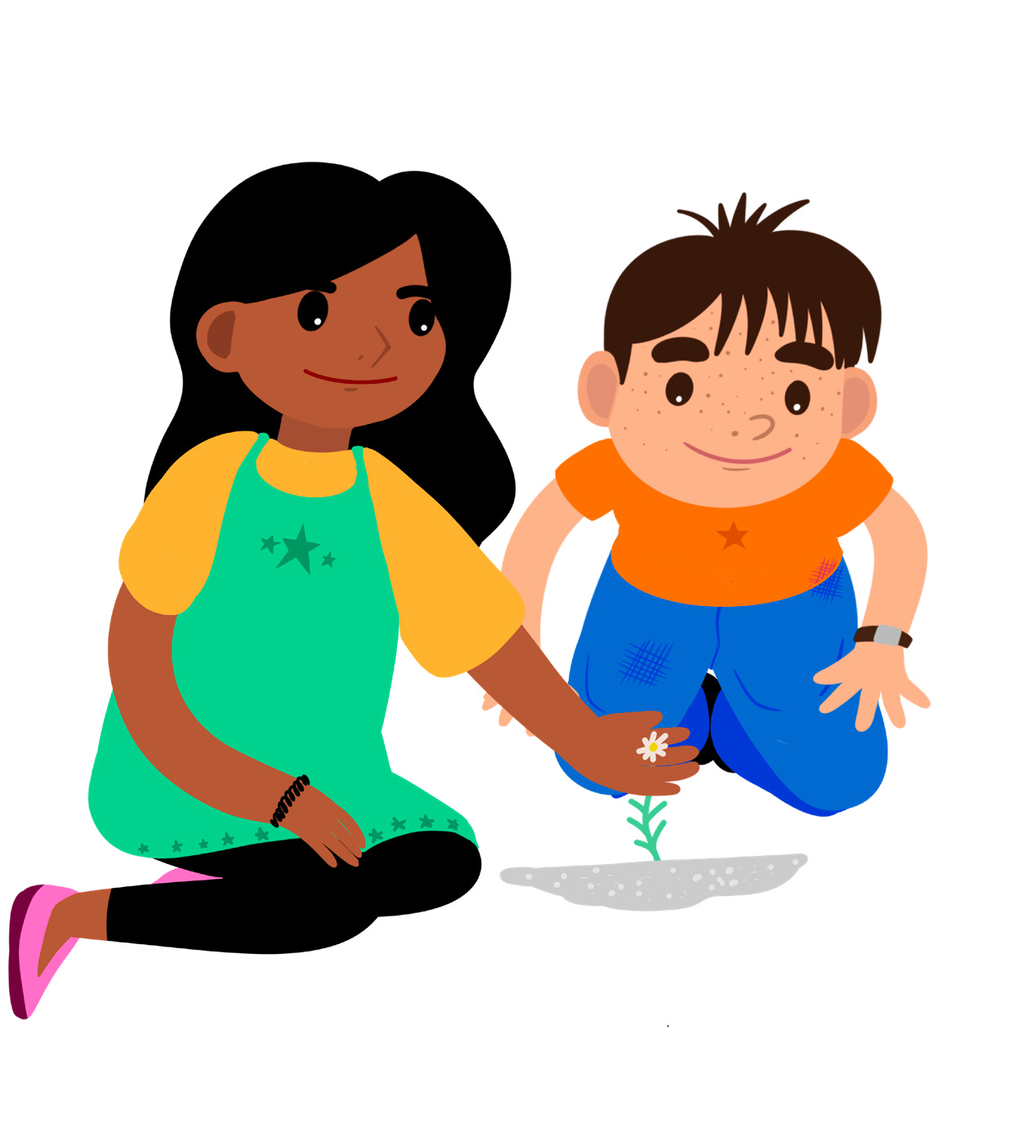







Plant Detectives
Activity card:
Zeke is going to play at Tara’s house. He’s about to open her gate when he notices a plant sticking out of a crack in the pavement. How exciting! Plants usually grow in gardens, not in pavements. How did the plant get there? He thinks that perhaps someone dropped it as they walked along, but who?
Zeke rushes inside to ask Tara to help him solve the mystery. She’s bound to know the answer. Zeke explains what he has found, but Tara isn’t sure how the plant got there either. She wonders if the plant might have
grown from a seed under the pavement, but who could have planted the seed?
Zeke and Tara know they have to look for clues to solve a mystery. They can’t wait to start searching. Tara’s grandmother, Joyti, loves plants, so she comes outside to help them. But where will they begin? Can you be plant detectives and help to find clues about plants that grow in unusual places?
Where have you seen plants growing?
Have you ever seen any plants growing in a pavement?
Zeke
Tara
Your challenge
Become a plant detective and help Zeke and Tara solve the mystery of where plants grow.

Slide 4











Discuss
Talk to your buddy and plan where you will go on your plant hunt.
Getting started
Have a good look around outside.
Look up and down, in corners, on buildings and patches of land. Remember, clues about plants might be hidden anywhere!
How can you make sure that everyone stays safe?
Test your ideas
Can you find any plants with flowers?
Can you find any plants growing in strange places?
Do you notice anything about where you find plants growing?
Share your ideas
Take photographs or draw pictures of
the plants you find to make a plant detective album. You could mark on a map where you found the plants. What is the strangest place you found a plant growing?
Extra things to do
Try to discover the names of the plants you found.
Try to find out if plants always need
soil to grow.
Would you find different plants at
different times of year?
British Science Association Registered Charity No. 212479 and SC039236

