Slide 1
Sniffly Sneezes
Supported by:

Slide 2
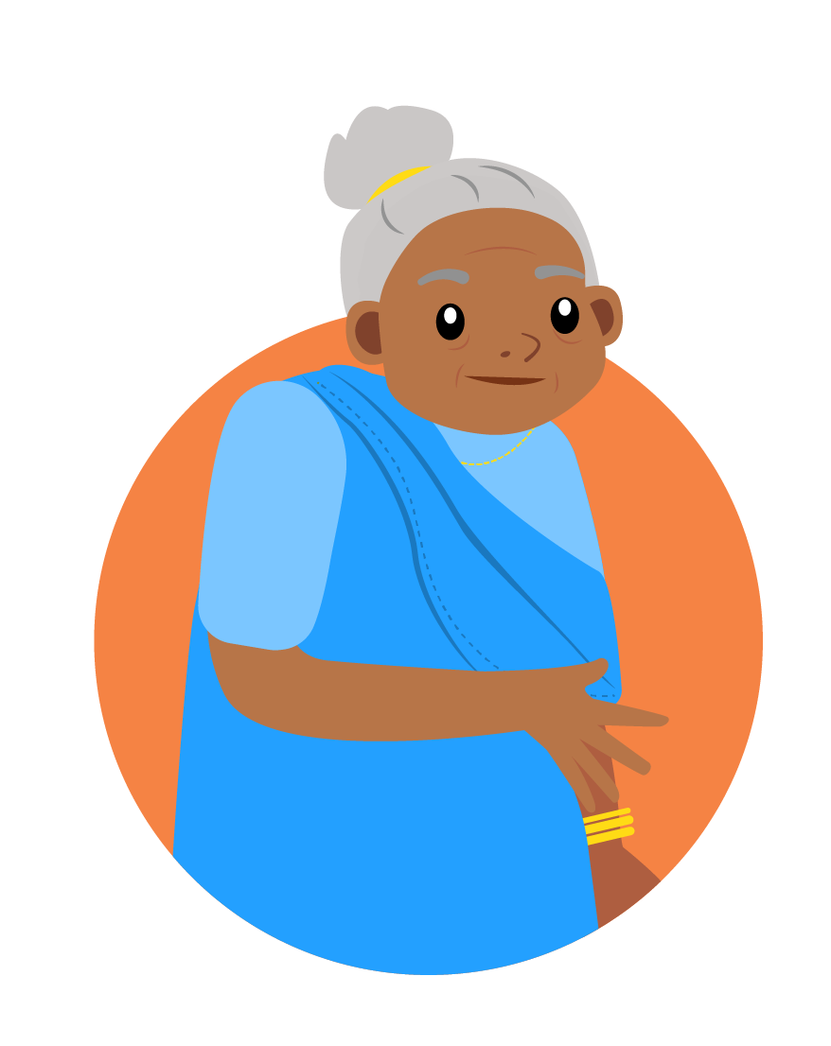
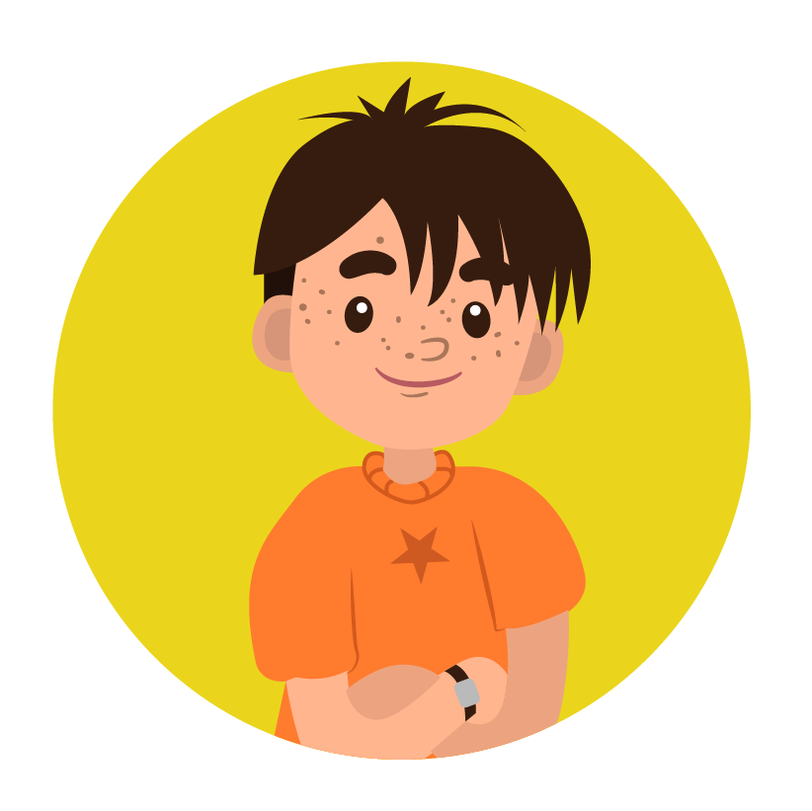
Meet the characters...
Tara
Zeke
Joyti
Grandmother to Tara

Slide 3
Poor Zeke has a cold.
I’ve brought you a lolly to cheer you up. Your nose is all red, it must be sore.
Achoo! Achoo! Achoo! Oh dear! What a horrible sniffly sneeze!

Slide 4
Poor Zeke has a cold.
It’s my hankie. It doesn’t work very well. I wish I had a better one.
I’m sure we can find something. I’ll ask my grandma, Joyti, to help us. She will have lots of things we could try. How will we know which is best?

Slide 5
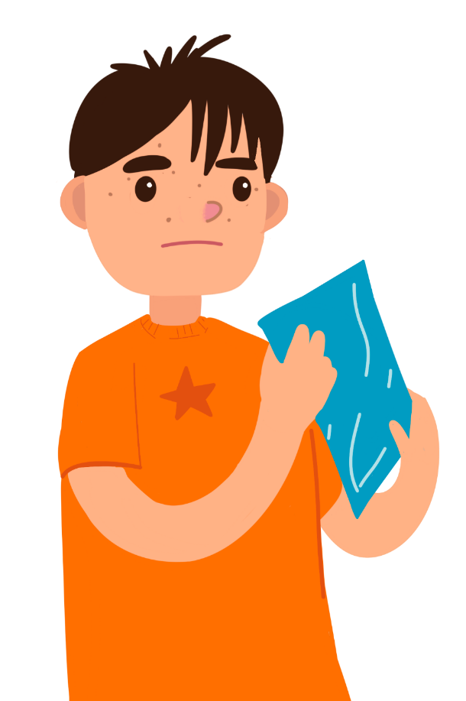
What makes a good hankie?
I think a hankie needs to be soft on your nose.
I think it needs to be strong when it is wet.
I think it needs to soak up water to keep your nose dry.

Slide 6
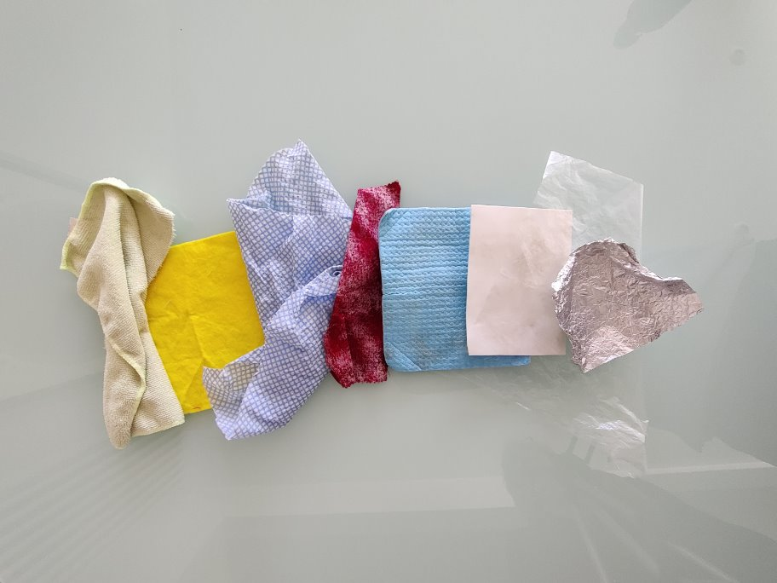
Which material will make the best hankie?
How will you find out?

Slide 7
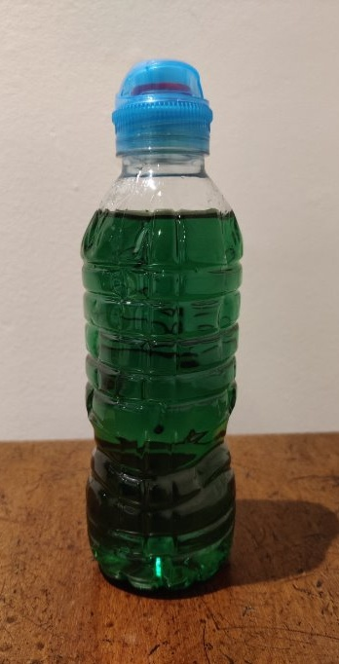
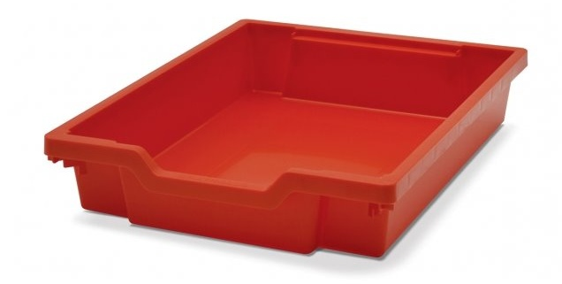
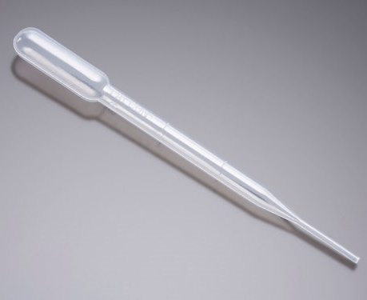
Testing the materials
tray
pipette
liquid

Slide 8
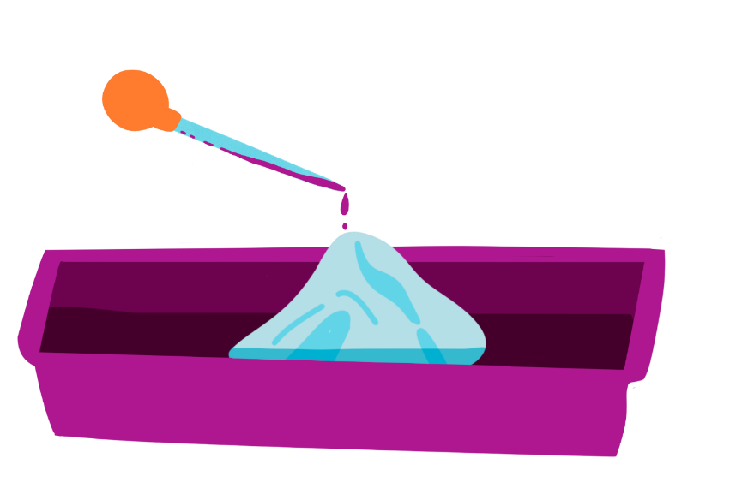
Recording your results
Sort the materials into the ones that worked well and the ones that didn't.
Did you get the same results as other children?
Which material would make the best hankie for me?

Slide 9
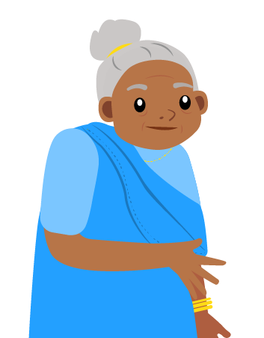
Take it further...
Why do we sometimes choose tissues that we can throw away?
A hankie needs to be able to soak up liquid. Are there any other tests we should carry out?

Slide 10
Well done!
You can add a stamp or sticker to your CREST Passport!

