Slide 1
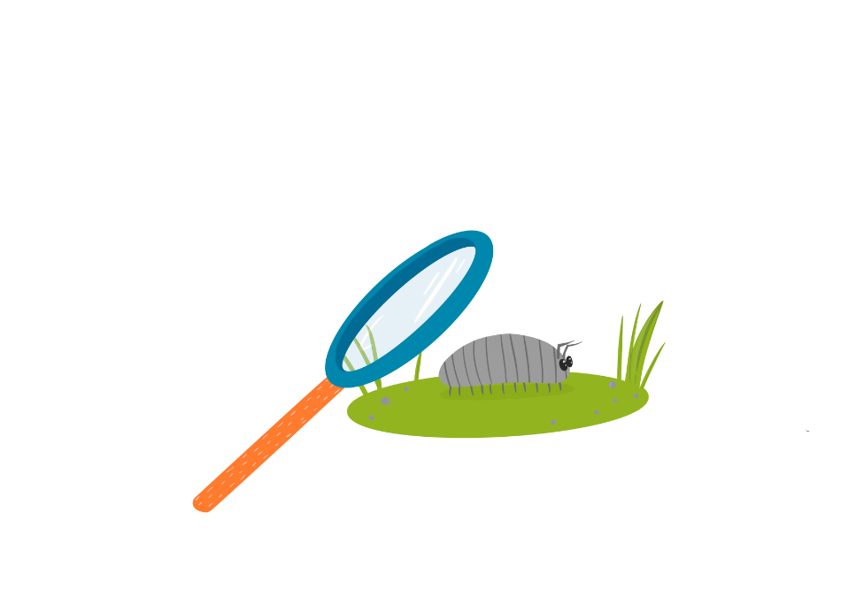
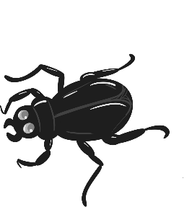
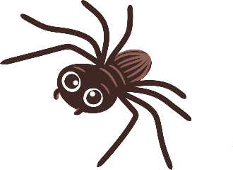
Animal Adventure
Supported by:

Slide 2
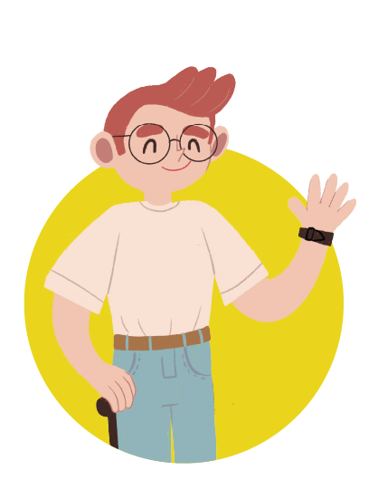
Meet the characters...
Cosmic
Seren
Uncle Astro
Uncle to Cosmic and Gem

Slide 3
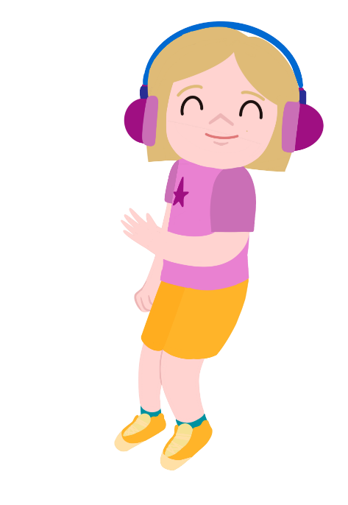
Cosmic and Seren are in Cosmic’s garden.
Let’s go on an animal safari!
Do you mean with toy animals?
They are trying to think of something to do.

Slide 4
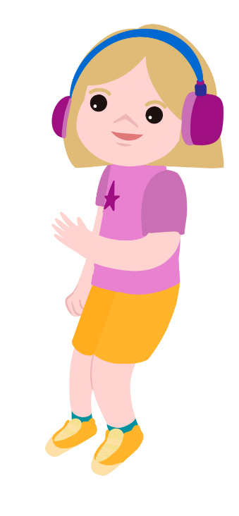
No, I mean a real animal adventure!
I can’t see any animals in the garden.

Slide 5
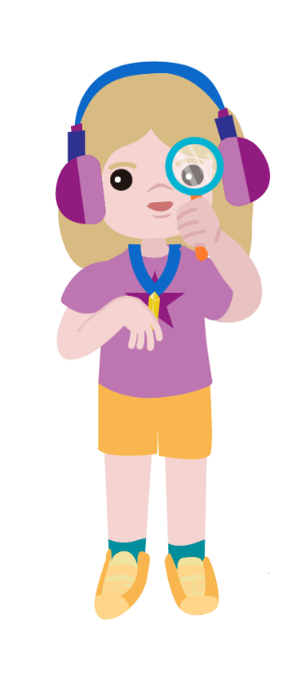
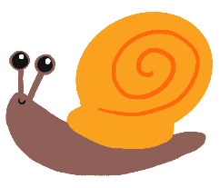
Uncle Astro says that there are little animals called minibeasts all around us.
We just can’t see them.
Let’s see if Uncle Astro can help us find them.

Slide 6
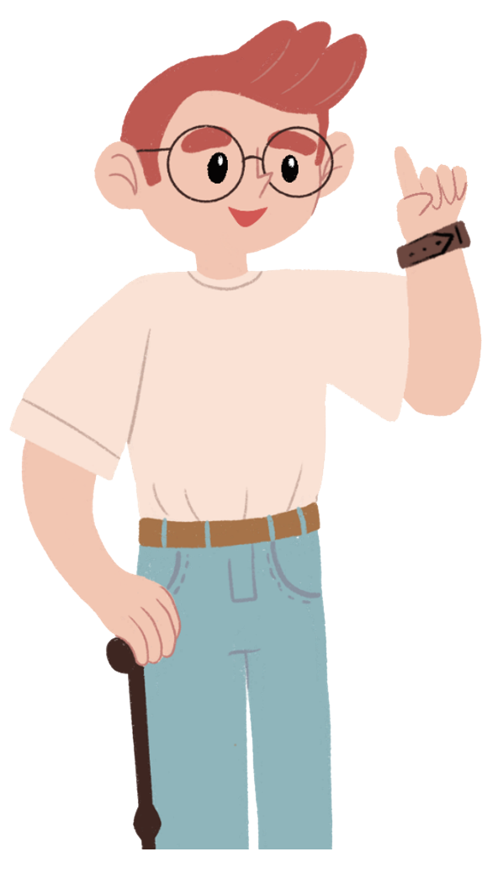
Where will Uncle Astro tell Cosmic and Seren to look?
I think we will find the minibeasts under logs and stones.
I think we will need to look in trees and on the top of walls.
What do you think?

Slide 7
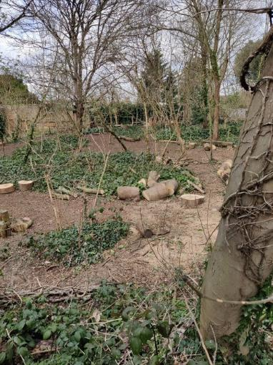
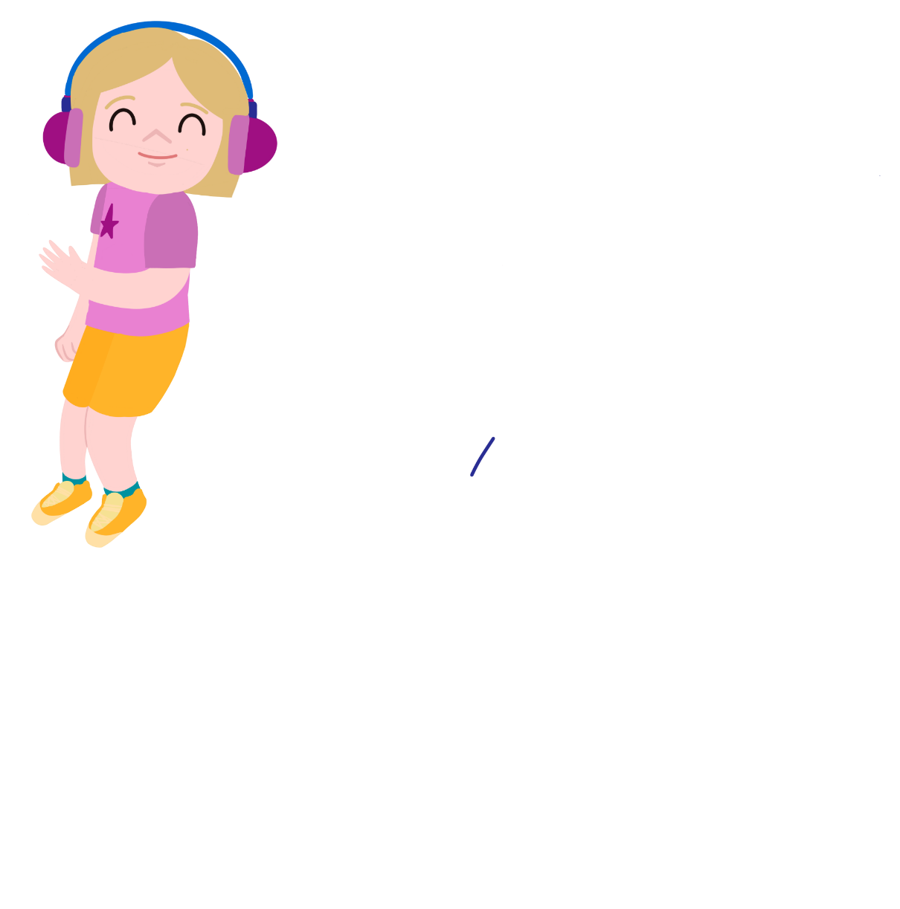
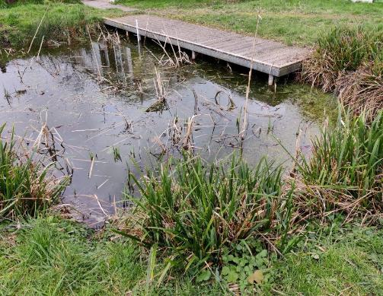
We are going on a minibeast hunt!
Where will we look for minibeasts?
How will we stay safe?

Slide 8
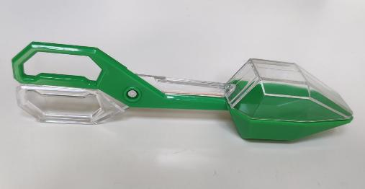
Collecting minibeasts
How will we make sure we don't harm them?

Slide 9
Looking at the minibeasts
You could draw the minibeasts that you find or take photos of them!
This magnifying glass makes things look bigger!
Do you know what any of the minibeasts are called?

Slide 10
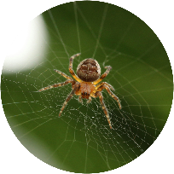
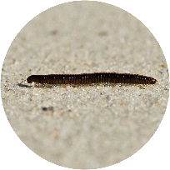
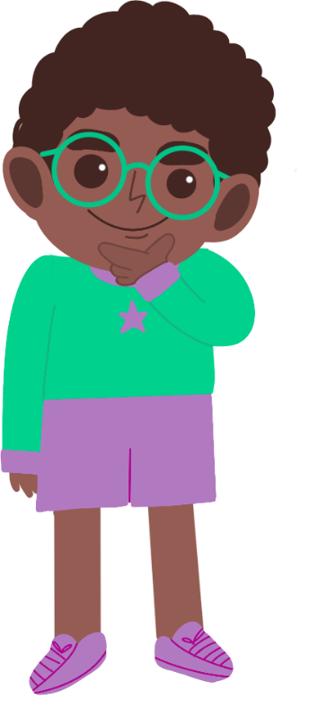
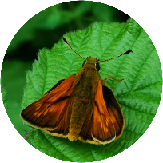
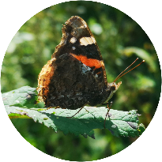
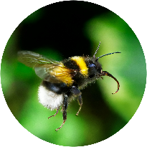
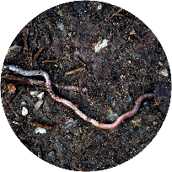
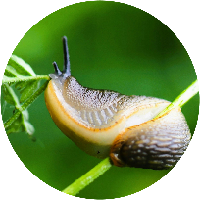
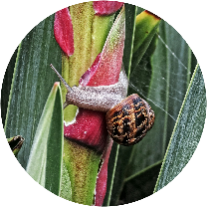
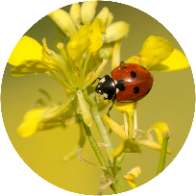
What did you find?
Where did you find the most minibeasts?
Where do you think they like to live?
Why?

Slide 11
Take it further...
Maybe you could design a home or bug hotel for the minibeasts!
Can you think of other places to look for minibeasts?​
Can you make up a song or poem about a minibeast?

Slide 12
Well done!
You can add a stamp or sticker to your CREST Passport!

