Slide 1

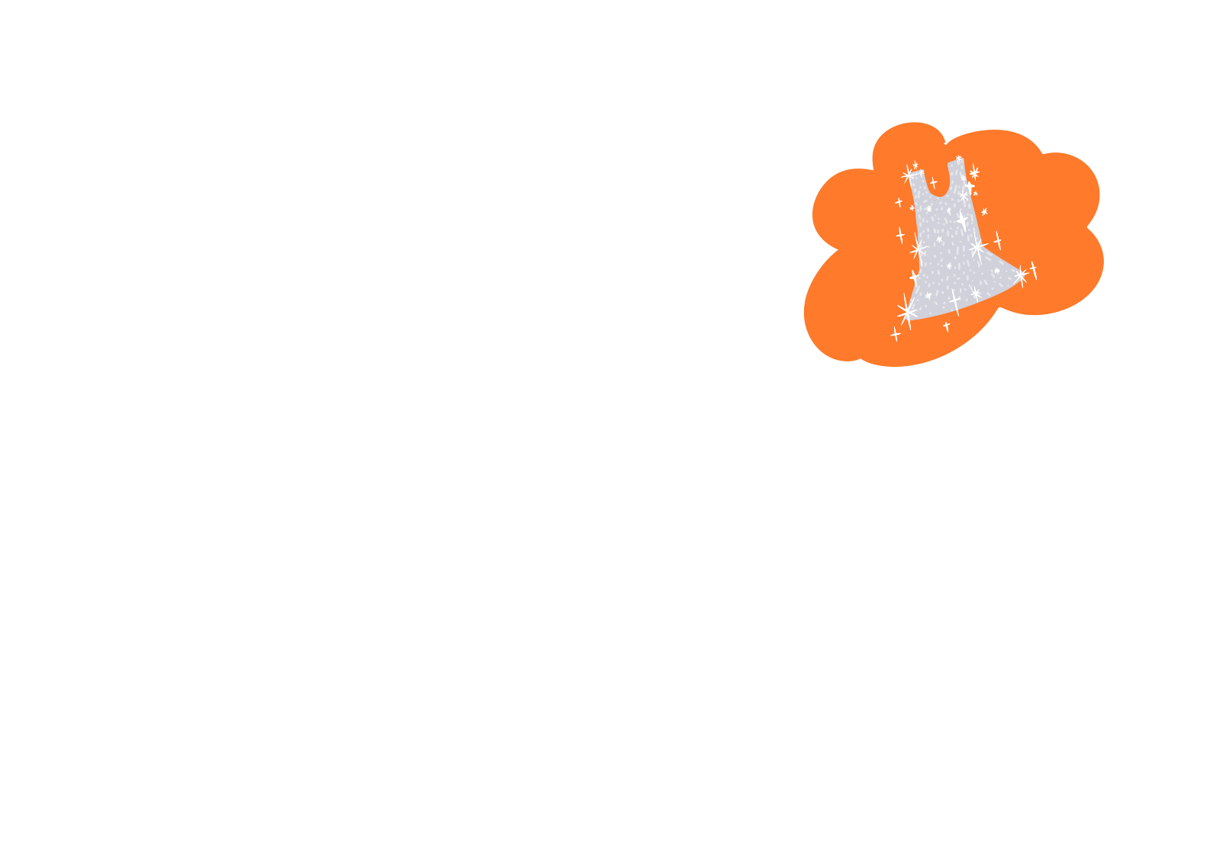

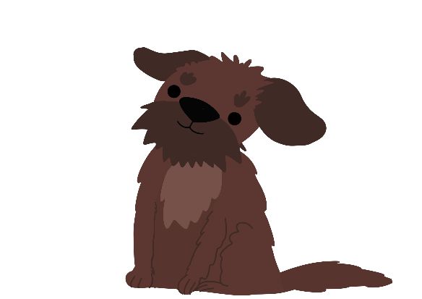

Be Seen, Be Safe
Supported by:

Slide 2

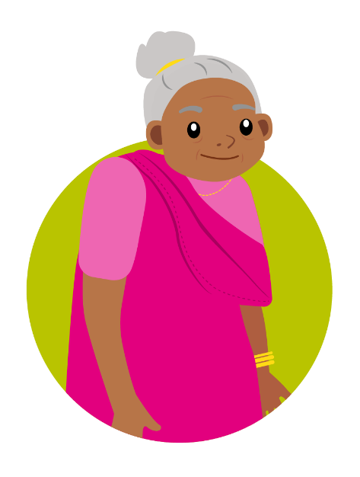
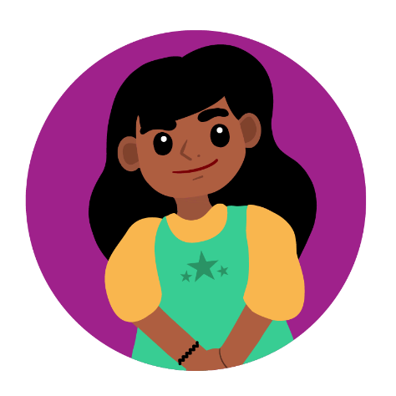
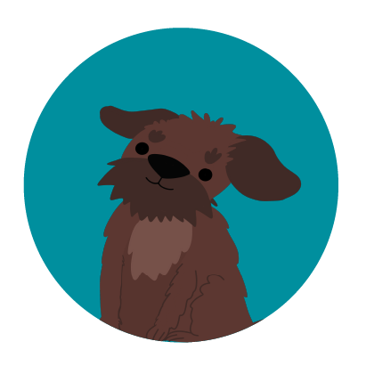
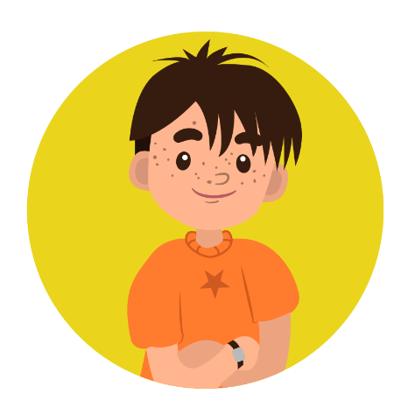



Meet the characters...
Tara
Luna
Zeke's new dog
Zeke
Joyti
Grandmother to Tara

Slide 3



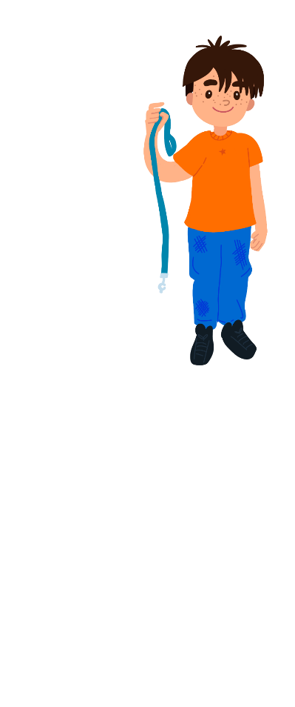
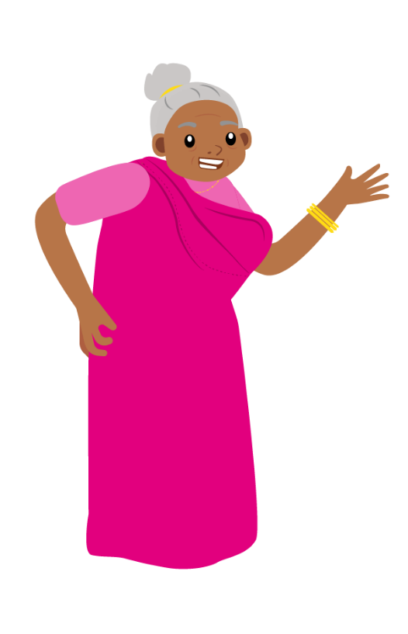
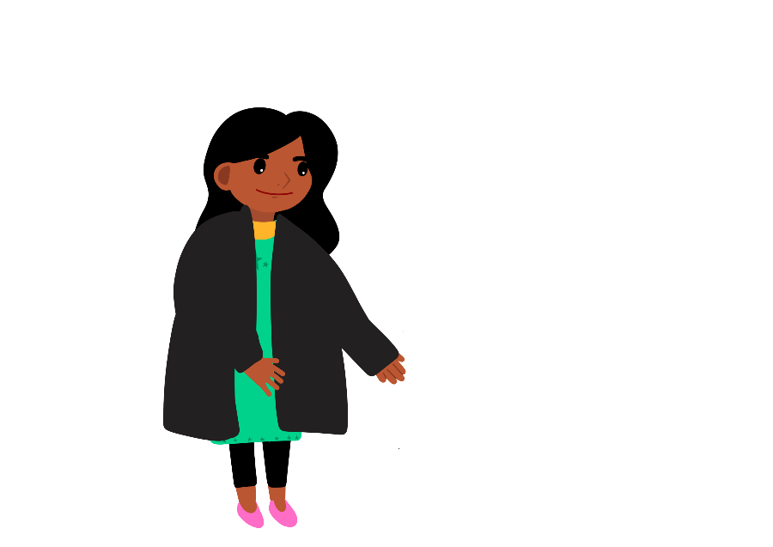
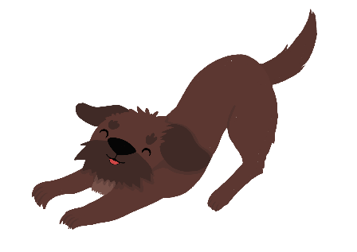
Tara can't wait to take Luna for a walk!
I’m so excited about taking Zeke’s new dog, Luna, for a walk this afternoon!
Hold on! It is going to get dark soon. It’s not safe to go out in your black coat.

Slide 4

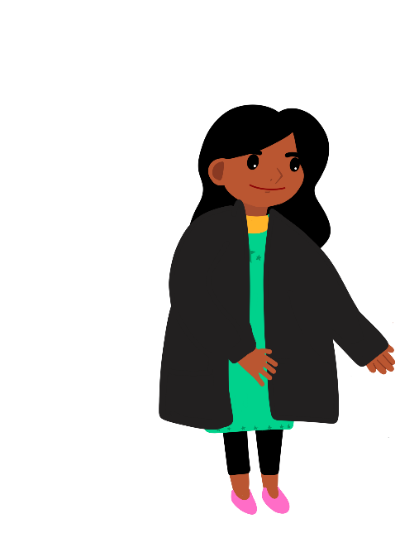

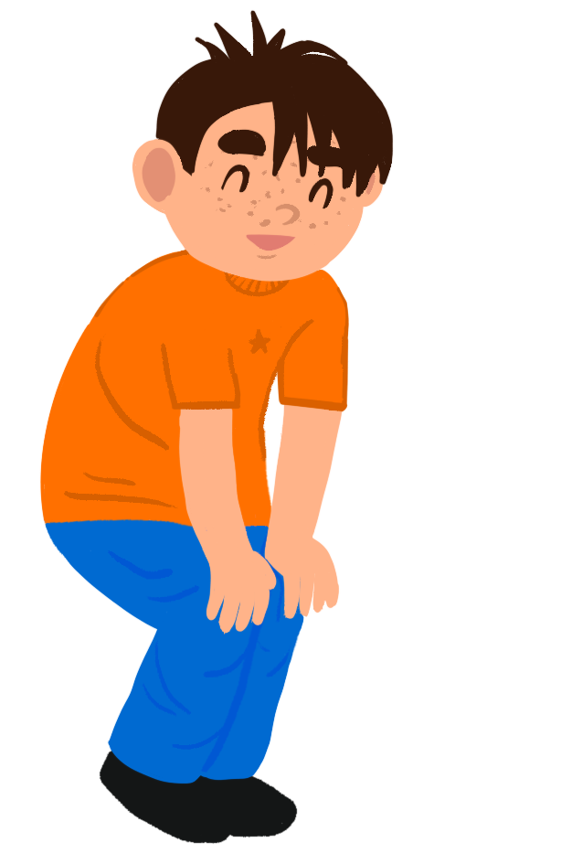
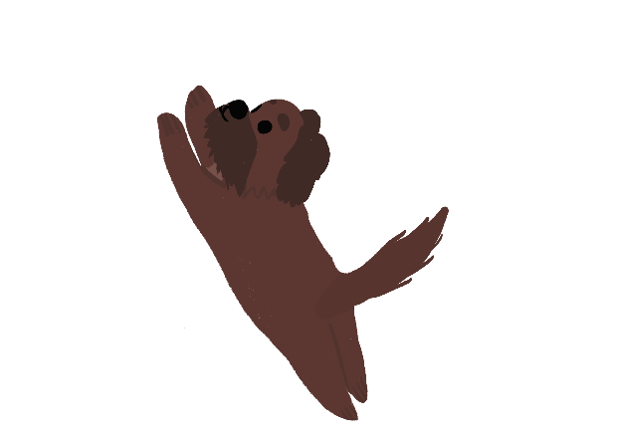
Tara's grandma thinks she needs to wear something different.
What do you mean?
Once it is dark outside, you won’t be seen in a black coat.
Let’s find you something that will keep you seen and safe!

Slide 5



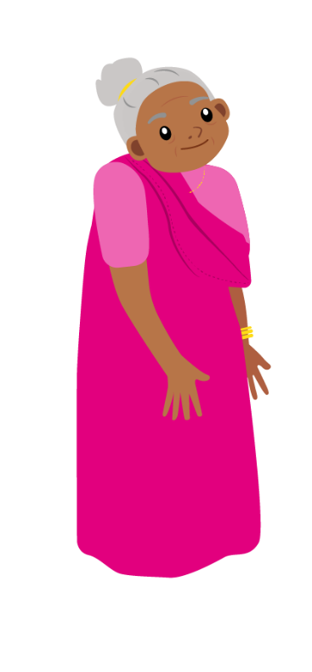
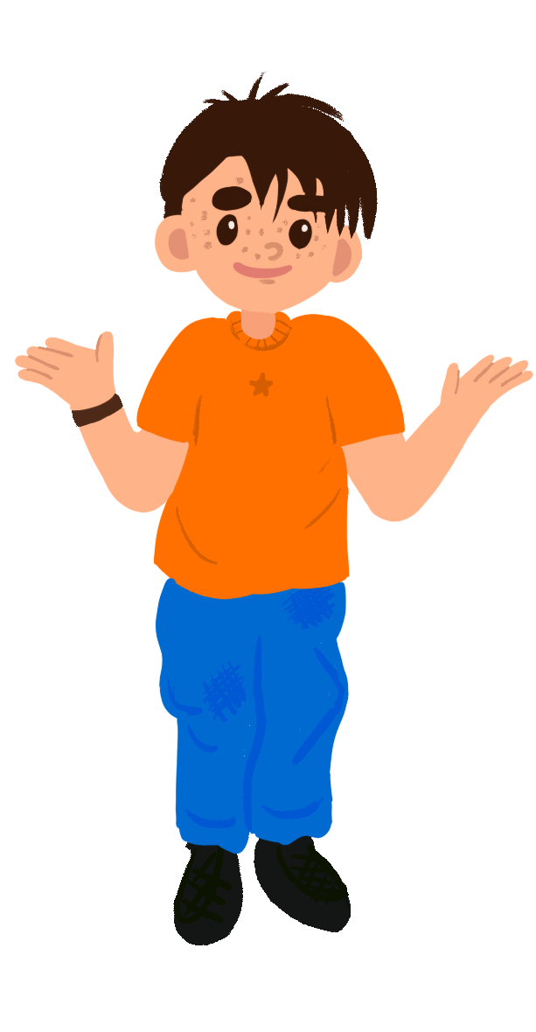

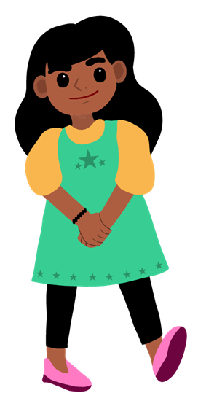

What do you think?
I think you should wear something white.
I don’t think it makes any difference what you wear.
I think I need to wear something shiny to be seen.

Slide 6

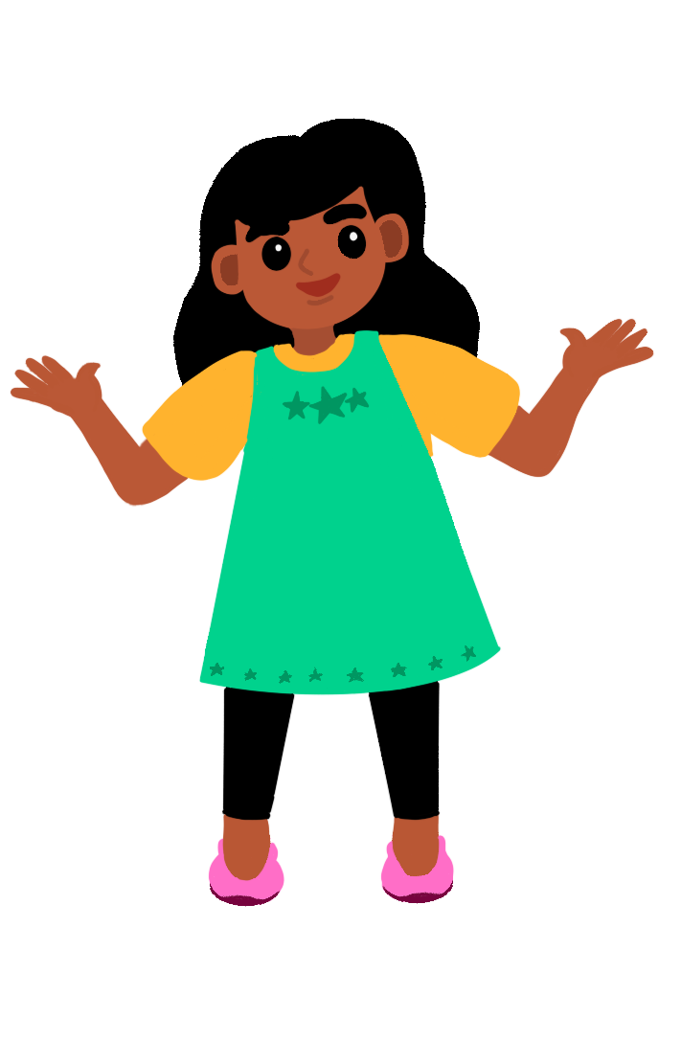
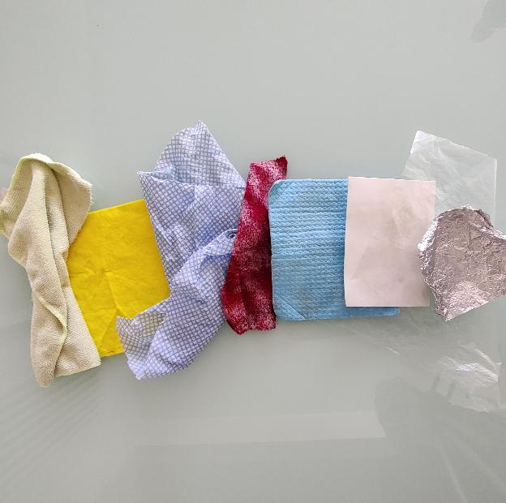
Which materials do you think can be seen in the dark?
How will you test them?

Slide 7


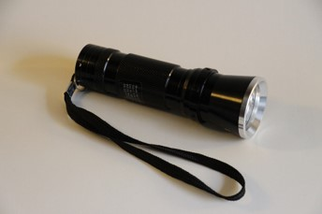
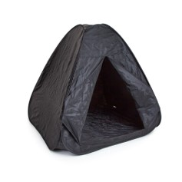
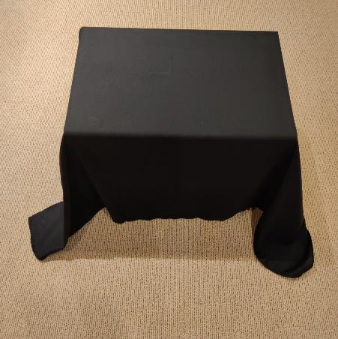
Testing the materials
Dark space
Torch

Slide 8



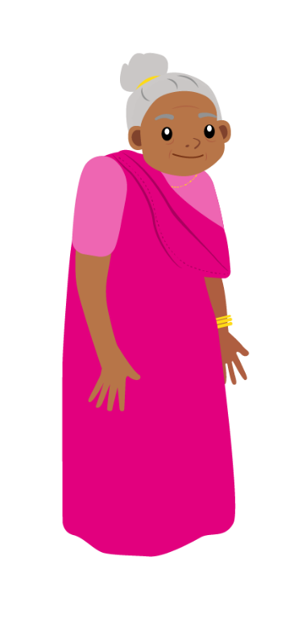

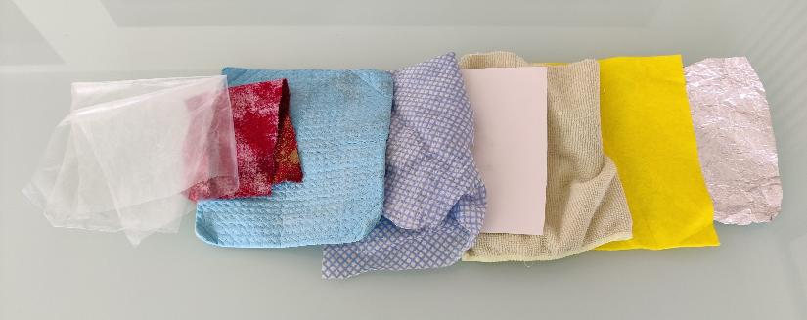
Recording your results
What should Tara and Zeke wear to be safe outside at night?
Put the materials in order from the most difficult to the easiest to see in the dark. You could take a photo!
Can you design something for them to wear?

Slide 9

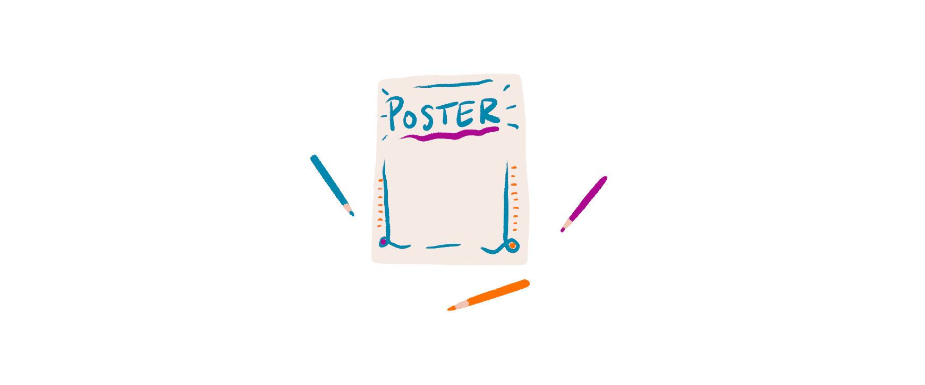
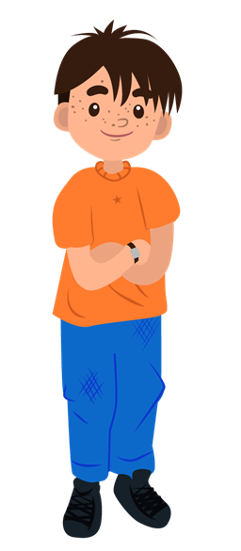


Take it further...
Can you make a poster to help other children stay safe outside at night?
Maybe I should design a special coat for Luna! Can you help me?

Slide 10

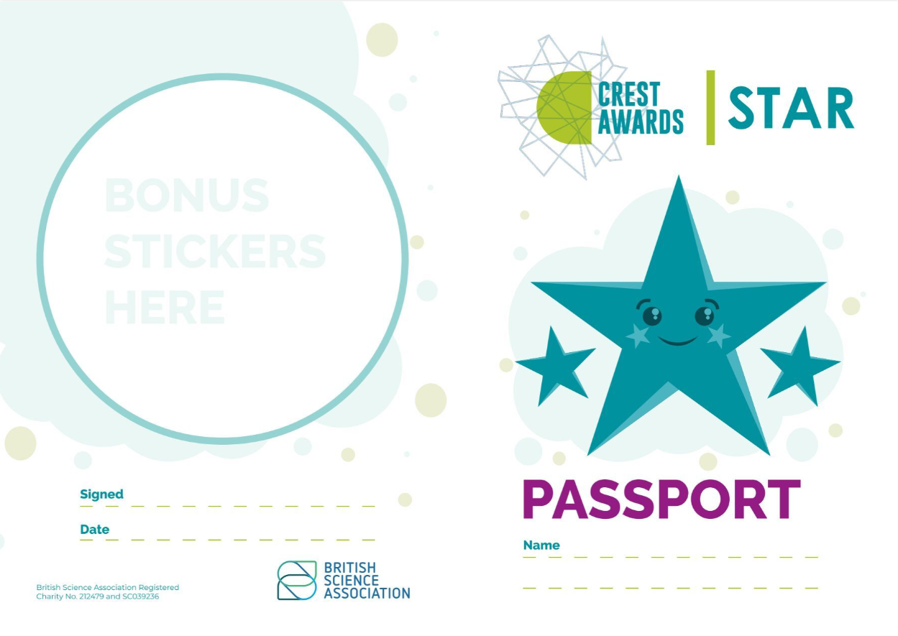
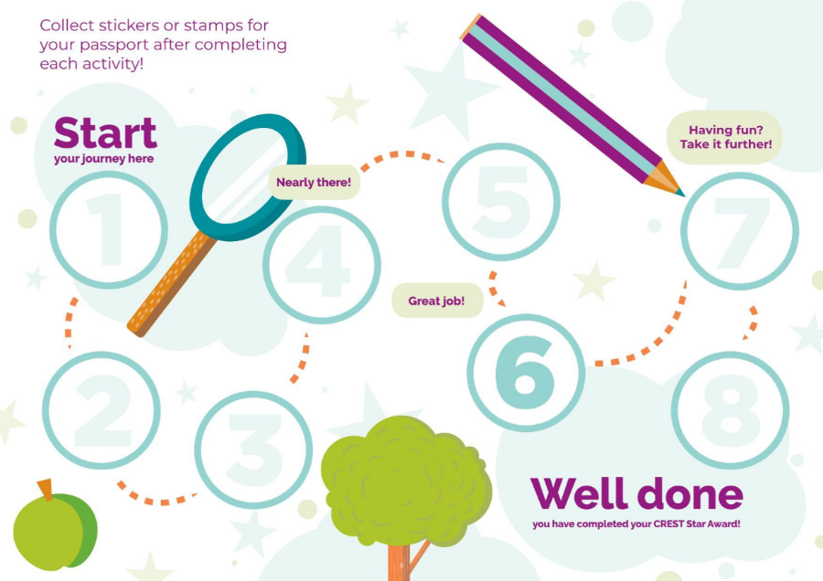
Well done!
You can add a stamp
or sticker to your
CREST Passport!

