Slide 1
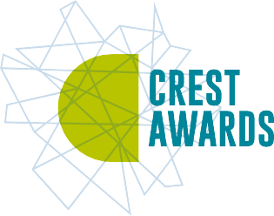
Peggy Problem
Organiser’s card:
About the activity
This activity is designed to get children thinking about grip and strength. The activity works best when run with small groups.
Kit list
A length of washing line, fixed at a suitable height for the children to reach
It’s washing day at Aunt Stella’s house. She cleans her clothes and then hangs them on the line to dry. The wet clothes keep falling off the line. Cosmic and Gem decide to try to find out which are the best clothes pegs for her to use. Will some clothes pegs be grippier than others?
Different types of clothes pegs (you could ask children to bring in pegs from home)
Through this activity you will support your group to:
Think about what makes a peg work well.
Socks
Something to gradually weigh down the socks – you
could use sand, large marbles or pebbles (pebbles can be numbered and used in the same order each time if they are different sizes)
Test different types of peg and observe how strong they are.
Record their results and share them with the group.
What to do
If you are using sand, you will also need small cups for filling the socks, a dustpan and brush and bowls or a floor covering to catch the sand
1. Introduce the activity using the story on the accompanying slides or activity card. Ask the children to talk about the questions and the opinions of Gem, Cosmic and Aunt Stella.
2. Talk through the idea of testing the pegs by adding sand, large marbles or pebbles to a sock on a washing line.
3. You could let them think of other ways of testing the clothes pegs too.
Key words
4. Discuss safety issues (see ‘Watch out!’ overleaf for more details). Then support children to carry out their investigation.
Grip
Weight
Spring
Pegs
Heavy
Light
5. Talk together about what they have found out. Were some pegs better than others? Which one worked best?

Slide 2
6. Let the children show their findings by drawing a picture or
poster, encouraging them to add as much detail as possible.
Watch out!
7. There are extra things to do on the activity card for children who have finished or who want to do more at home.
If you’re using sand, put a bowl or mat underneath the washing line for the sand- filled socks to fall onto.
Things to think about
If you’re using marbles or pebbles, ensure that they are large enough not to be a choking hazard. Children should be reminded to take care with the sand, marbles or pebbles and not to drop or throw them, or put them in their mouths.
If you are using sand to weigh down the socks, make sure that the children empty the sock as much as they can each time so that each peg is tested the same way. Otherwise get a collection of socks and use a new one each time. Test the socks to check that the sand does not leak out!
If you are using pebbles, you could number them and use them in the same order each time, testing the pegs one by one. As pebbles are not completely uniform in shape and size, this will ensure that each peg is tested in the same way. Is there another way to check that the pebbles used are the same each time?
Can children think of a different way of testing the pegs?
Be careful where you hang the line so that children cannot run into it. Keep the line low so that the socks do not have too far to fall,
and the children can reach it easily.
The first pegs were probably sticks with a slit in one end used by fishermen hanging their washing on the rigging while out at sea. It wasn’t until the ‘spring-clamp’ was invented in 1853 that pegs started to resemble those we use today.
Children should be careful when handling pegs, particularly those with spring hinges, to avoid getting fingers and skin trapped.
It is important that the children are able to feel like ‘real scientists’ during this activity and know that their own ideas are important too. If children do come up with their own tests, try to let them have a go, provided you have the equipment, and the test is safe.
Children should be reminded not to rub their eyes if they are handling
sand and to wash their hands afterwards.
Take it further
Children could try weighing the pebbles each time as part of the testing.
Pegs can also be tested in many other ways. For example, measuring the clamping pressure of sprung pegs. You can do this by attaching the pegs to plasticine and measuring the depth of the indentation.
Can you think of any other jobs that a peg might be used for?
British Science Association Registered Charity No. 212479 and SC039236

Slide 3
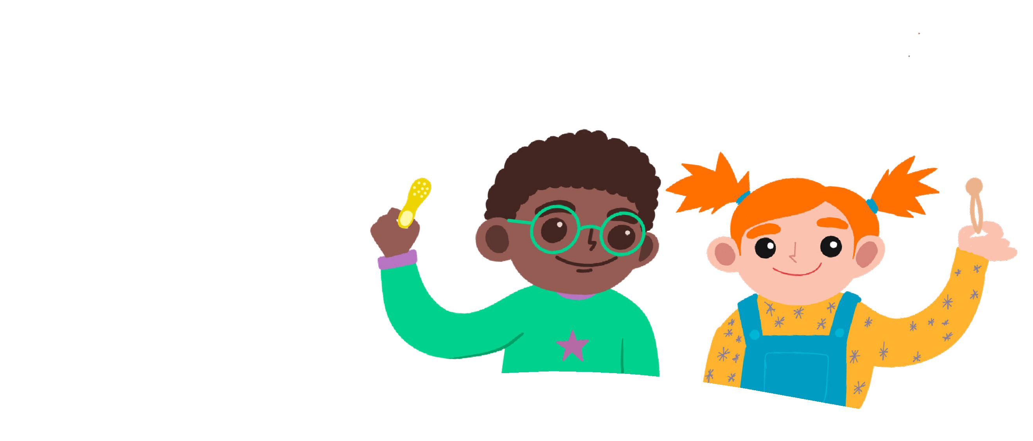
Peggy Problem
Cosmic
Gem
Activity card:
Aunt Stella looks out of her kitchen window. “Warm and windy... looks like the perfect washing day.” she declares, as she rolls up her sleeves to wash her clothes.
When they are all clean, she carries the heavy, wet pile outside to hang on the washing line to dry. Cosmic and Gem’s friendly faces appear.
“Just in time to help.” Aunt Stella smiles, and soon the washing line
is filled with brightly coloured T-shirts, socks, skirts and jumpers.
The three of them head into the house for a well-deserved glass of apple juice.
“Oh no!” Cosmic shouts with surprise. “Some of the clothes have fallen off the line onto the grass! I don’t think your clothes pegs are grippy enough for the heavy, wet clothes.”
“We’ve got different clothes pegs at home, perhaps they would
be better.” suggests Gem, looking thoughtful.
“We could test them for you, Aunt Stella.” they offer eagerly.
Aunt Stella thinks a peg with a spring will have the most grip.
Cosmic thinks all the plastic pegs will have a tight grip.
Your challenge
Gem thinks wooden pegs might be better
as she thinks wood is stronger.
Test different types of clothes pegs and find out which ones are good for keeping washing on the line.
Have you ever helped to hang clothes out to dry at home?
What type of clothes pegs did you use?

Slide 4
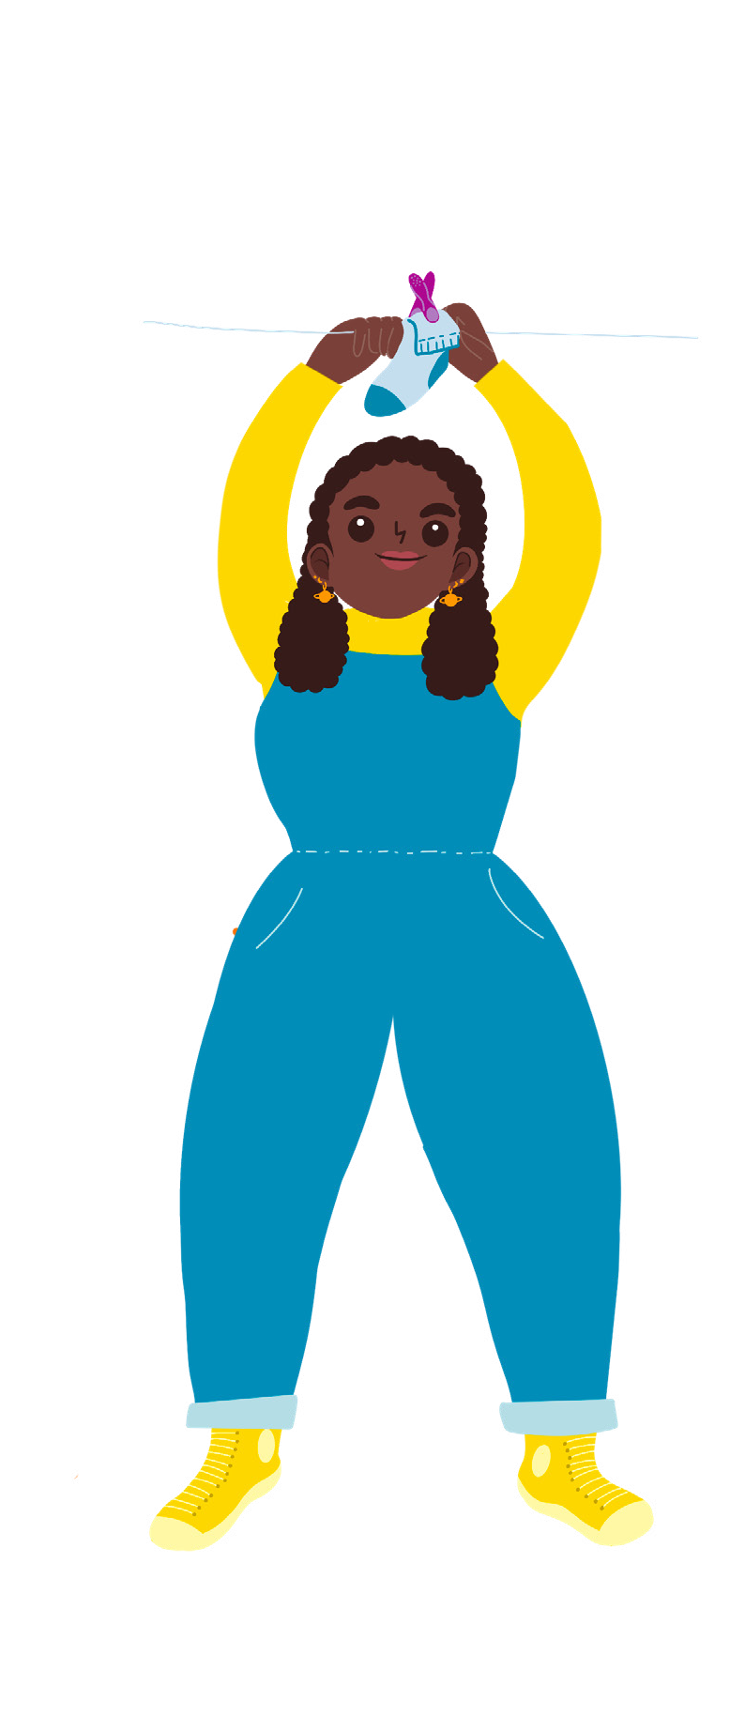
Discuss
Plan how you can test different clothes pegs. How are you going to find out which pegs are strong and grip things well?
Getting started
Aunt Stella
Collect different types of clothes pegs.
Make your own washing line with a thin skipping rope
or string. Don’t fix it too high - ask an adult to help you!
Choose one peg to hang a sock on the washing line.
Keep filling the sock with cups of sand, large marbles or pebbles until it falls off the line. Make sure you keep track of how many you use!
Test your ideas
Try other pegs and see which type has the strongest grip (which can hold the most sand, marbles or pebbles in the sock).
Stand well back from the falling socks and don’t rub your eyes with sandy fingers.
Can you think of other ways to test clothes pegs?
Share your ideas
Extra things to do
Find out if clothes dry better on a windy or a still day.
Find out if some clothes dry faster than others.
Try to work out how to dry clothes on a rainy day.
Take a photo or draw a picture of each peg and write down the number of pebbles, marbles or cups of sand it took to pull it off the line!
You could order the pegs from the one with the least grip, to the one with the most grip.
Which peg should Aunt Stella use? Draw or paint a picture of your tests.
You can use the best peg to hang
your picture on the washing line.
British Science Association Registered Charity No. 212479 and SC039236

