Slide 1
Testing Timers
Organiser’s card:
About the activity
This activity is designed to get children thinking about how sand timers work. You could run the activity with small groups, or with a whole class.
Kit list
Real sand timers
Cosmic, Gem and Seren are practising for sports day. They need a timer to work out how many beanbags they can get into the hoop in one minute, but they are not allowed to throw things in the kitchen near the clock. They want to make a timer to take into the garden. Uncle Astro thinks that they can use sand to make a timer.
Dry paper cups
Dry sand
Sharp pointed pencil to make holes (use some sticky tack or plasticine underneath the cup to help)
Through this activity you will support your group to:
Stopwatch or clock with second hand (you could use a countdown timer on a tablet or on your whiteboard)
Compare real sand timers and observe which variables affect the time they measure.
Experiment with different hole size and quantities of sand in their own sand timer.
Test their sand timer and reflect on how it could
be improved.
You might like to use trays or a covering on the tables where the children are working
What to do
Water, sugar, salt etc (optional alternatives to sand)
Introduce the activity by reading the story on the accompanying slides or activity card together. Get the children to talk about the questions and the opinions of Cosmic, Gem and Seren.
Discuss how to make sure they carry out the task safely.
Let the children look at real sand timers first. Then encourage them to explore different cups and sizes of hole before they try to make their one-minute timer.
Talk together about what they have found out. Can they explain why they have different answers to how much sand you need? What would they change to improve their timer?

Slide 2
5. Children can create pictures or take photographs of their timer. Encourage them to add as much detail as possible including design features and the amount of sand.
Key words
6. They can try out each other’s timers by playing the ‘beanbag and hoop’ game.
Time
Timer
Measuring
Minutes
Seconds
7. There are extra things to do on the activity card for children who have finished or who want to do more finding out at home.
Things to think about
Watch out!
Some children may not have seen sand timers, so they may
need to play with manufactured ones first.
Sand on the floor can be
very slippery.
Children can change the type and amount of sand and/or
the size of the hole. Let them explore this, with support if they need it.
Remind children not to rub their eyes when they are handling the sand and to wash their hands afterwards.
Making the timers will be easier if children work in pairs or small groups.
Children can use clocks or stopwatches to test their timer. If they find this difficult, let them compare their timer with a manufactured timer.
Adult supervision may be required to make the holes in the cups. Make the hole from the inside of the cup. Use a soft surface underneath the cup, you could use a blob of sticky tack or plasticine.
Take it further
The earliest records of sand timers date from the 14th century and they were often used as timers in factories and on
sailing vessels. Sand timers are also known as sandglasses or hourglasses. Today, sand timers are frequently found in kitchens and board games.
If you are using sugar or salt as an alternative to
sand, ensure that the children do not taste it or put it in their mouths.
It required great skill to create very accurate sand timers with the beautiful hourglass shape and a tiny hole to control the flow of the sand.
British Science Association Registered Charity No. 212479 and SC039236

Slide 3
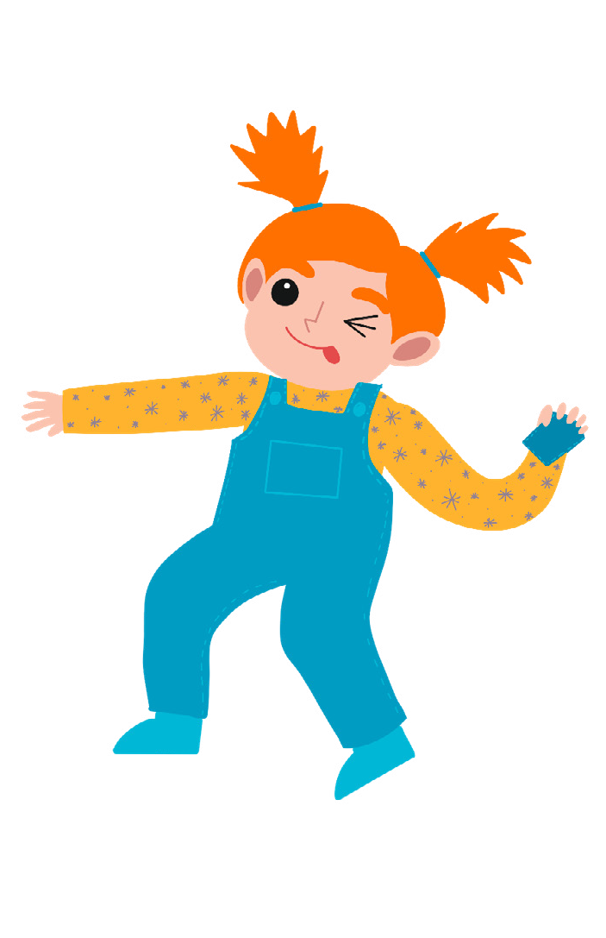
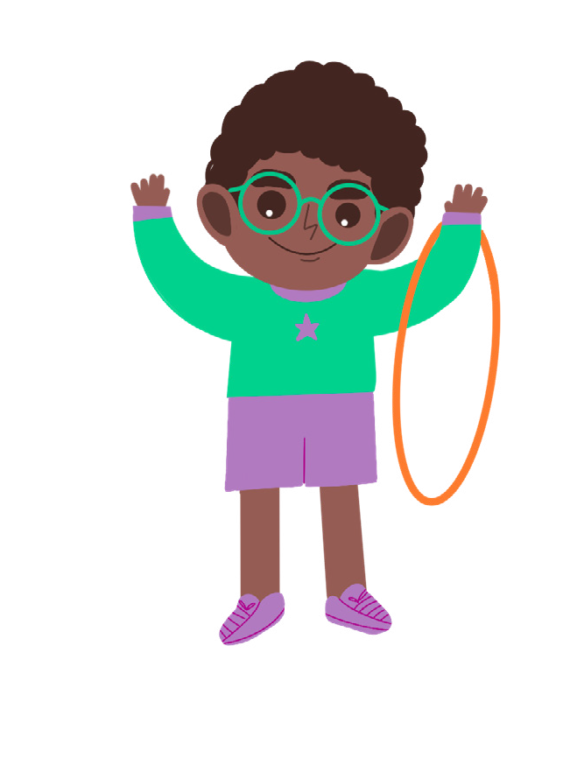
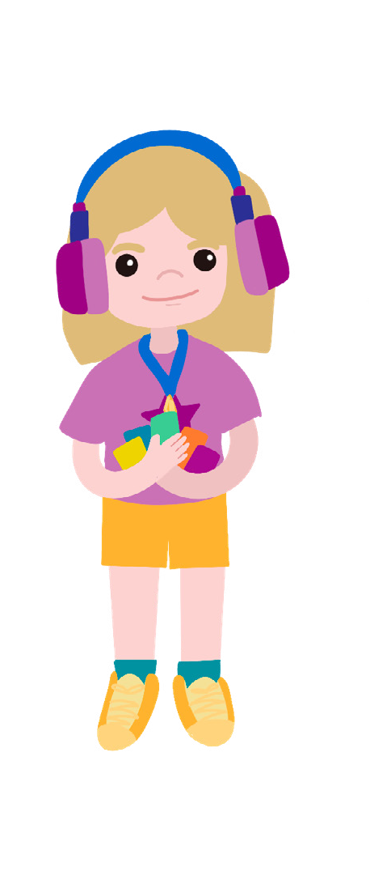
Testing Timers
Gem
Seren
Activity card:
Cosmic
It will soon be sports day and Cosmic, Gem and Seren are very excited. They have all been chosen to take part in their favourite game. They will have just one minute to throw as many beanbags as they can into a hoop.
“Let’s get practising,” says Cosmic.
“Good idea, we can start straight away,” replies Gem. “I think there’s a hoop and some beanbags in the garden, and we can use the clock on the kitchen wall to time ourselves.”
They are having a wonderful time until Uncle Astro comes into the kitchen to check how his cakes are getting on in the oven. “What are you three getting up to now?” he says with a smile, “Off you go into the garden before something gets broken.”
“But we won’t be able to see the clock from there,” cries Cosmic.
“And then we can’t time one minute to see how many beanbags we get in the hoop,” adds Seren.
“Why don’t you make a timer that you can take outside?” suggests Uncle Astro. “There’s some sand in the shed that might be useful.”
Have you ever seen a sand timer? How do you think a sand timer works? Cosmic thinks you’ll need a lot of sand to measure one minute.
Gem thinks you only need a little bit of sand.
Seren thinks it might depend on the size of the hole in the timer. What do you think?

Slide 4
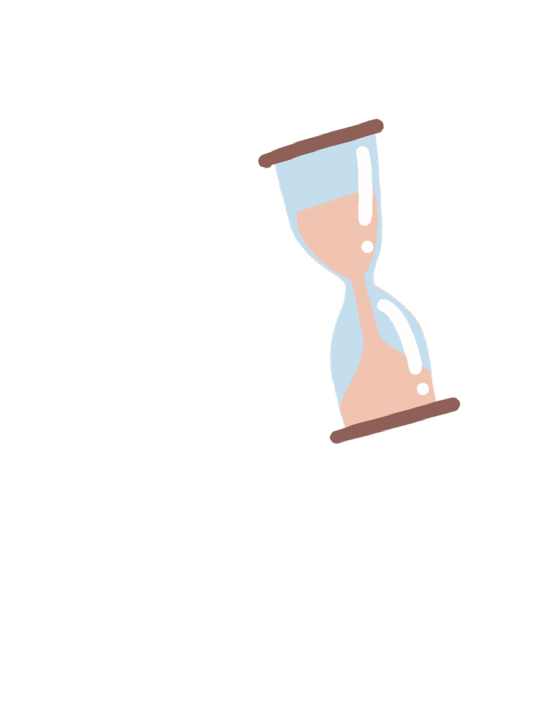
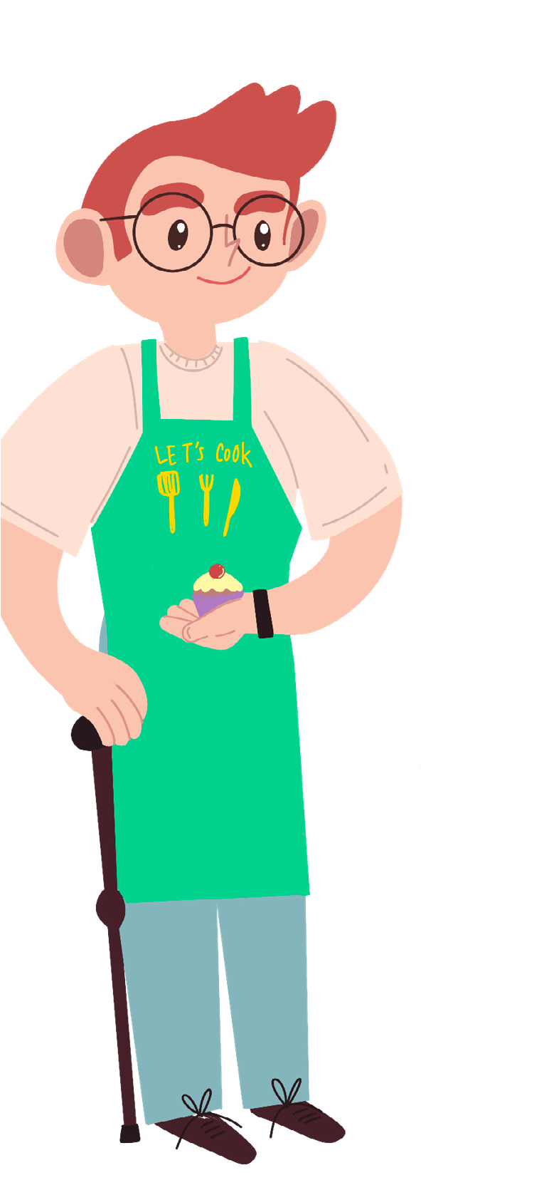
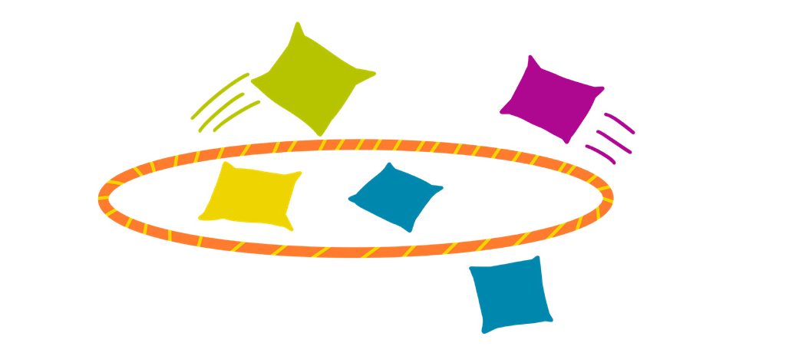
Your challenge
Discuss
Can you make a timer using sand? Can you make your timer run for exactly one minute?
Talk to your buddy about how you can make your timer and how much sand you will need.
Getting started
Make different size holes in the bottom of paper cups with the point of a pencil. Ask an adult to help you with this.
Explore what happens when you put sand in the cups. You can catch the sand in another cup!
How do you think you can stop the sand getting out too soon?
Uncle Astro
Test your ideas
Share your ideas
Try each of the cups. What changes how long it takes the sand to come out?
Can you make the sand run for exactly one minute?
Try out your timer by playing the beanbag and hoop game with your friends.
Draw some pictures or take photographs to show how to make a sand timer.
You could make a short video explaining how a sand timer works.
Extra things to do
Try putting more holes in your timer and see what happens.
What else can you use to make a timer?
Where do you find sand timers? What are they used for?
British Science Association Registered Charity No. 212479 and SC039236

