Slide 1
Useless Umbrella
Supported by:

Slide 2
Meet the characters...
Aunt Stella
Auntie to Cosmic and Gem
Cosmic
Seren

Slide 3
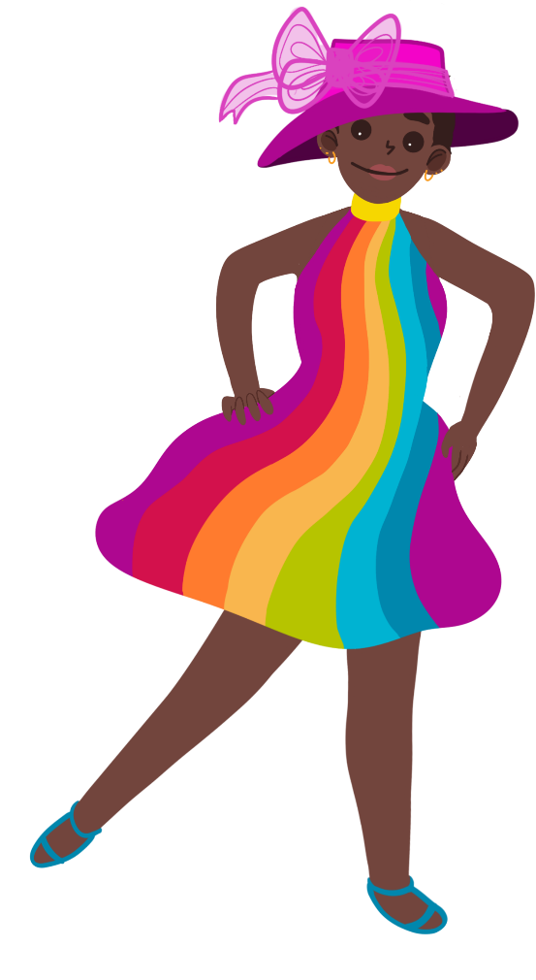
Aunt Stella is off to a wedding.
You look great, but you should take an umbrella in case it rains!
What do you think of my special outfit?

Slide 4
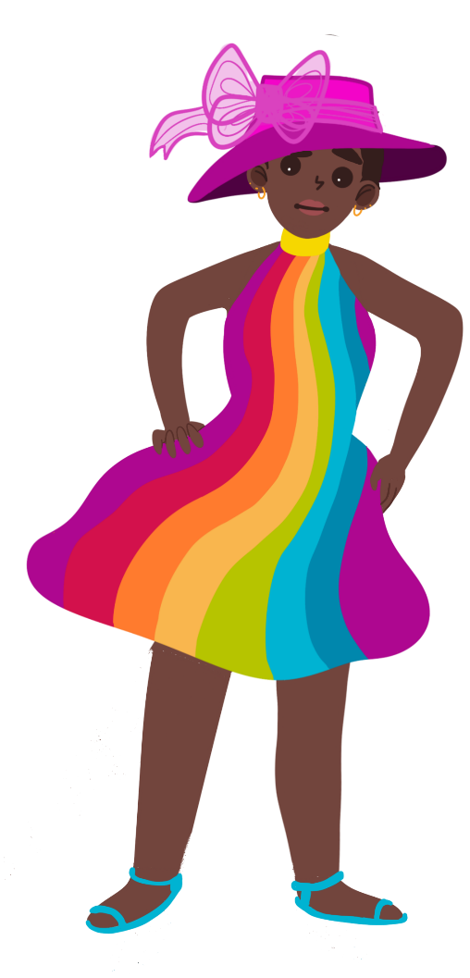
There is a problem.
I don't have another one. What am I going to do?
Oh no! The umbrella is full of holes. It's useless!

Slide 5
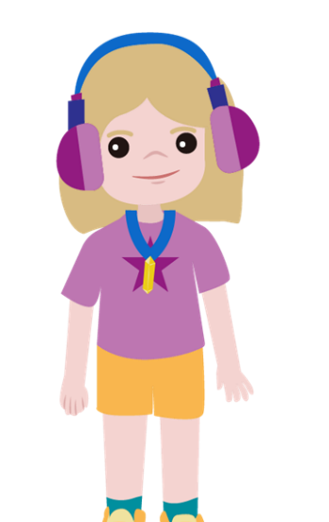
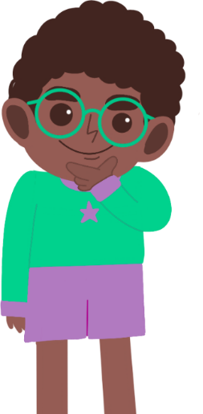
Cosmic and Seren think they can fix the umbrella.
I think we need a brightly coloured, thin fabric to make it waterproof.
I think we need to use a sponge to make it waterproof.
I think we need a thick fabric to make it waterproof.
What do you think?

Slide 6
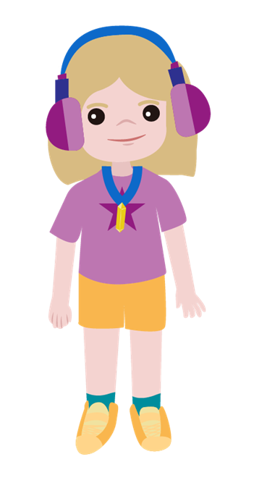
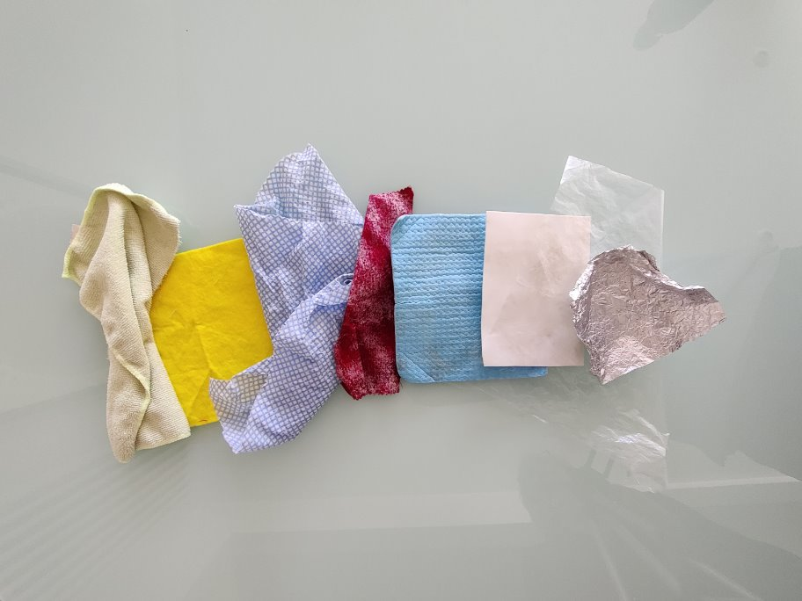
Which materials could fix the umbrella?
How will you find out?

Slide 7
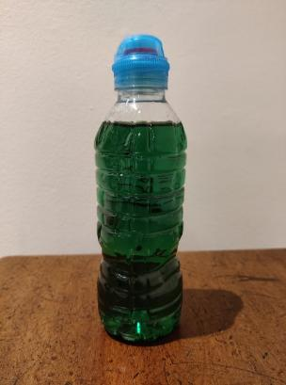
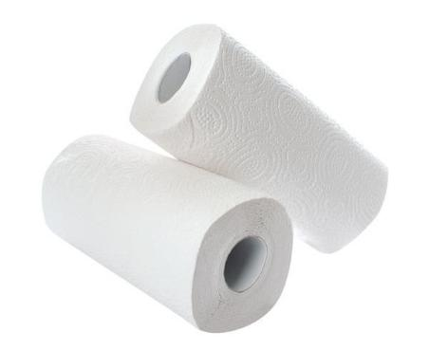
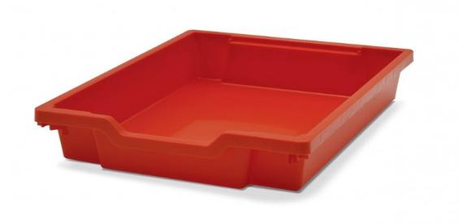
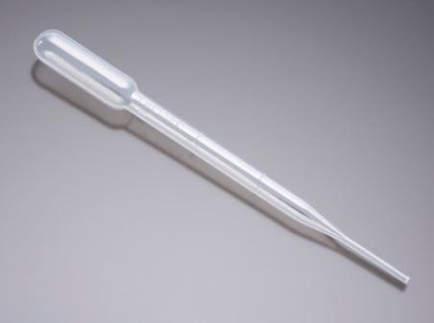
Testing the materials
paper towel
liquid
tray
pipette

Slide 8
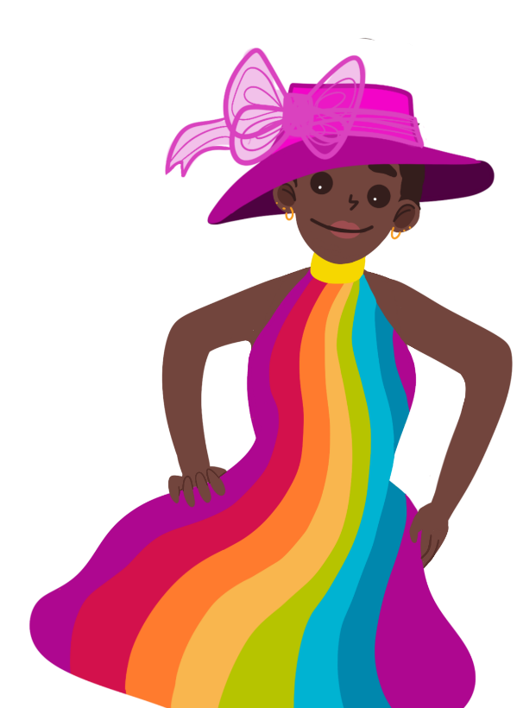
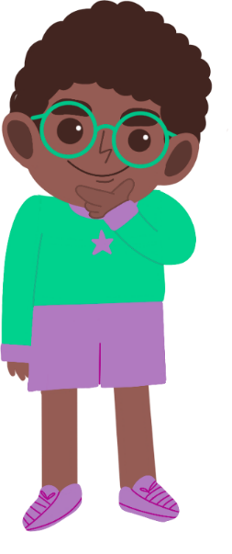
Recording your results
Would all the waterproof materials be good for fixing my umbrella?
Why?
You could sort the materials using a hoop.

Slide 9
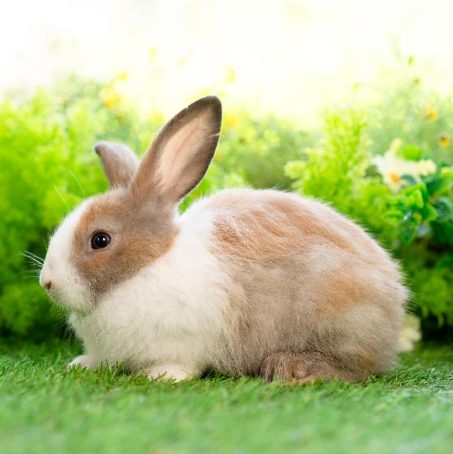
Take it further...
Can you think of some other things you might want to keep out of the rain?
Can you think of a way of keeping them dry?

Slide 10
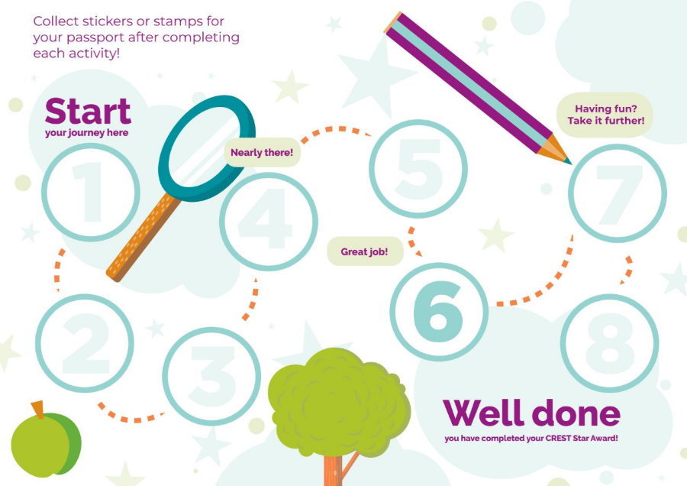
Well done!
You can add a stamp or sticker to your CREST Passport!

