Slide 1
Sneaky Shadow
Organiser’s card:
About the activity
This activity is designed to get children thinking about shadows. You could run the activity with small groups, or with a whole class.
Kit list
Torches or other light sources
Seren has lost her shadow. She knows that it was with her all day but now it is missing. Gem and Aunt Stella try to help her to find it. Gem finds it under an outside light and Aunt Stella finds it on the wall. Where has the sneaky shadow been hiding?
Card or thick paper
Scissors
Sticks to attach to the shadow puppets
Through this activity you will support your group to:
Sticky tack or sellotape
Experiment with making shadows indoors and outside.
Coloured transparent material (this can be interesting to experiment with)
Create a shadow play to share.
What to do
A shadow theatre – this could be a small table-top theatre, or a large screen made from a sheet.
You will need: a light source (e.g. torch, projector or bright lamp) and a screen (e.g. tracing paper stuck
to a cardboard frame, or a white sheet)
1. Introduce the activity using the story on the accompanying slides or activity card. Ask the children to talk about the questions and the opinions of Seren, Gem and Aunt Stella.
2. If it is sunny, you could go outside first to look at shadows.
3. Children can explore shadows using torches or other light sources.
4. Set up a shadow theatre for the children to explore.
Musical instruments (optional)
5. Children can cut out a variety of shapes e.g. people, animals or cars. They can then attach their shapes to sticks to make simple puppets and use them to create a shadow play. Some children may need help to think of a story for their play.
They can experiment with coloured transparent material. Is it possible to make a coloured shadow?
Let them share their plays with each other. They could add sound effects using musical instruments!
There are extra things to do on the activity card for children who have finished or who want to do more finding out at home.

Slide 2
Things to think about
Key words
Children may think that shadows are there all the time, even when it is dark. They may think that shadows have faces or coloured clothes. It is important that they are allowed to talk about and explore their own ideas, without being told that they are wrong.
Shadows
Light
Dark
Colour
Block
A shadow theatre is ideal to disseminate the information. Put a bright light source behind a screen. Children hold their cut-out characters on sticks in front of the light and behind the screen so that the shadows are cast on the screen. The plays can be shared with each other.
Watch out!
Take it further
Make sure children do not touch a hot light source.
As children explore, they will find that the closer the object
is to the light source, the bigger the shadow. The shadow is always on the opposite side of the object from the light source.
Observe your organisation’s policy for working outdoors.
You do not need complete darkness to explore shadows with torches or other light sources. Light coming through a window can form shadows. However, it can be helpful to minimise light coming through windows to make the shadows formed by torches clearer.
Do not look directly at the Sun.
Do not look directly at a bright light source.
Beware of trip hazards if working in dark conditions.
You can access further guidance on exploring shadows on the CLEAPSS website, in Guide P138.
British Science Association Registered Charity No. 212479 and SC039236

Slide 3
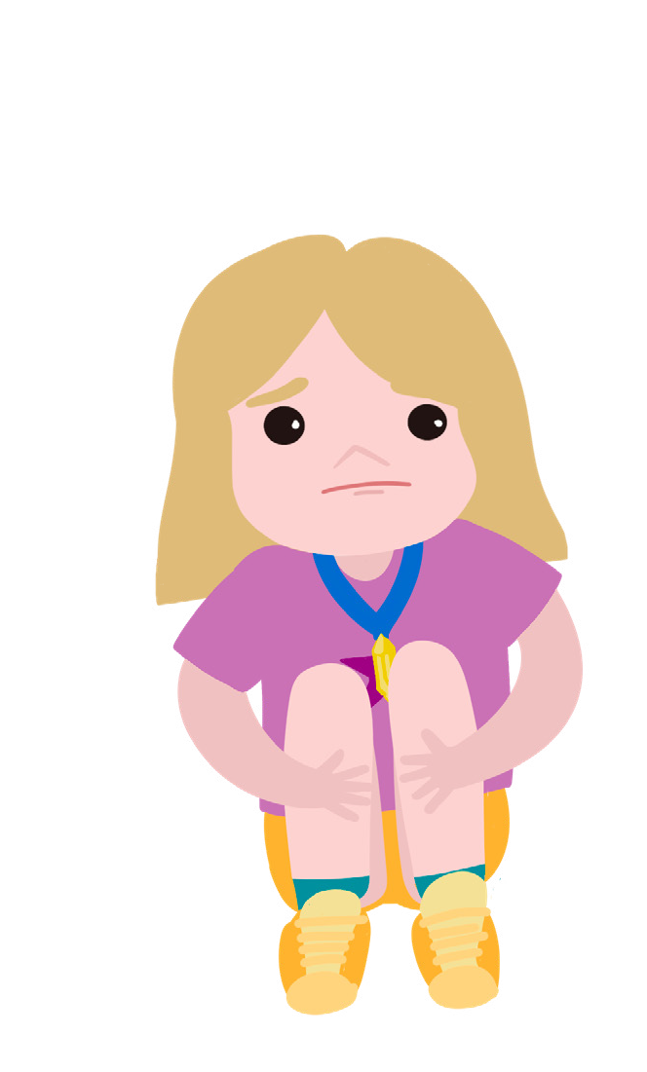
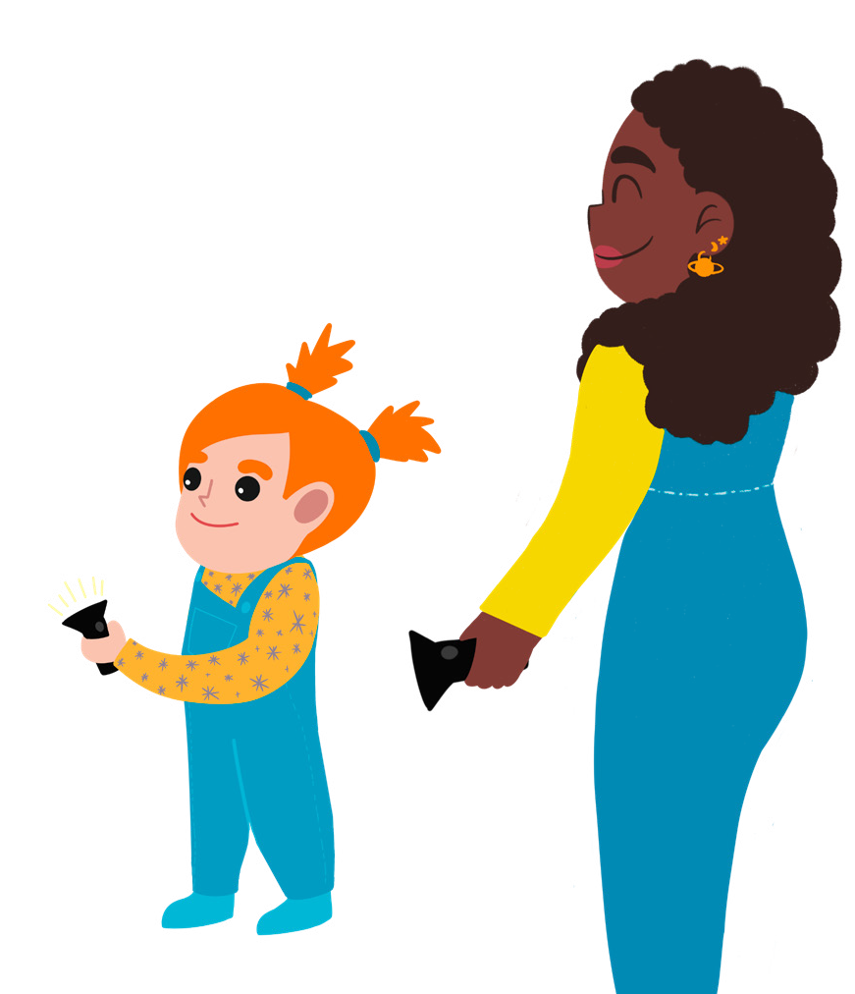
Sneaky Shadow
Activity card:
Seren
Seren is very worried. Her shadow is missing. It was there when she was outside playing. It was still with her when she walked home from school. But now it is nowhere to be seen.
Seren goes to play at Gem’s house, perhaps her shadow is in Gem’s garden. Aunt Stella is looking after them and says they can go outside to look for it. It is late afternoon and getting dark.
“Come here quickly,” shouts Gem. “I’ve found a shadow!” Gem is under an outside light, looking down at her feet.
Seren runs over and looks down at her feet too. “You’ve found it! Great!” But when the outside light goes off, her shadow is missing again. Oh no!
Just then Aunt Stella comes out of the house. She is carrying a big torch. “I’ll help you find your sneaky shadow,” she says, waving the light around the garden, “and there it is!”
There on the wall is Seren’s shadow. “Wow! Where did that come from?” asks Seren.
Can you guess?
Aunt Stella thinks you will see your shadow if there is bright light. Gem thinks you can only see your shadow when the sun is shining. Seren thinks shadows hide when it goes dark.
Have you ever looked at your shadow? Does your shadow ever disappear?
Aunt Stella
Gem

Slide 4
Your challenge
Discuss
Find out what makes a shadow and what makes it disappear.
Talk to your group about how you are going to find out.
Getting started
You could go outside to look for shadows. What do you see? Can you find places where you can see your shadow and where your shadow disappears?
If you are indoors, try using a bright torch.
Make shapes in front of the light with your hands. What do you see?
Make some little people or other shapes from card. What happens when you put them in front of the light?
Test your ideas
Can you think of other things that you can do to make shadows and see whether Gem, Seren or Aunt Stella is right?
You could use your little people to make a shadow play. Ask an adult to help you to set up a shadow theatre.
Share your ideas
Talk about why Seren’s shadow was missing.
Share your shadow play.
Can you explain how to make a shadow?
Extra things to do
Can you make different coloured shadows? Can you make your shadows change size? Make up more shadow plays.
British Science Association Registered Charity No. 212479 and SC039236

