Slide 1












Sniffly Sneezes
Organiser’s card:
About the activity
This activity is designed to get children thinking about the strength and absorbency of materials. You could run the activity with small groups, or with a whole class.
Kit list
A selection of different materials that could be used as hankies e.g. cotton fabric, newspaper, crepe paper, cotton wool, tissue paper, greaseproof paper, tissues.
Achoo!! Zeke has a cold and his hankie isn’t working very well.
Can you help him find a better one?
Through this activity you will support your group to:
Think about what makes a good hankie
Plastic trays
Beakers
Test different materials and observe how they behave when used to absorb water
Coloured water (dissolve a drop of food colouring or paint in a beaker of water, this will make the liquid easier for the children to see)
Record their results and share them with the group
What to do
Pipettes
Paper towels to clean up any spills
Introduce the activity using the story on the accompanying
slides or activity card. Get the children to talk about the questions and the opinions of Zeke, Tara and Joyti.
Then give the children a set of materials to test as hankies. Let them talk about which they think might be best and how they will find out, before they start investigating.
You could list the different tests they might want to do e.g. absorbency, strength, smoothness. Make sure that they test all the different materials. Encourage them to use their own ideas too.
When they have finished, agree on the winners and talk about why these were the best hankies. You might ask the children to think about why we have disposable tissues.

Slide 2











5. To present their work the children could:
Key words
Sort the materials into those that worked well and those that didn’t.
Put the materials in order, from the one that soaked up the most water, to the one that soaked up the least. Take a photo and compare it to other children’s results!
Wet
Dry
Strong
Weak
Soft
Rough
Germs
Absorbent
Durable
Make a collage, using bits from the different hankies.
Produce a poster, using smiley faces and sad faces to
indicate how good the hankies are.
Things to think about
Encourage children to think of all aspects of what makes a good hankie.
Get them to think carefully about the amount of water used in the absorbency test.
Watch out!
There is no easy way to measure for roughness. The children can estimate how the hankies feel, perhaps using a simple 3-point scale e.g. smooth, rough and in-between.
Mop up spills to avoid a slippery floor.
Warn children not to squirt coloured water at each other.
Take it further
Test hankies on hands, not
noses.
The hankie’s absorbency depends on a number of factors, including the thickness of the fibres and size of the spaces between them.
Remind children not to share hankies.
The hankie’s strength is important. Cheap tissues can be absorbent, but they may fall apart easily when wet.
Ensure children do not taste or put the liquid or materials used in this activity near their mouths. If you are using food colouring for this activity, it can stain children’s hands.
How rough the hankie feels is essential, especially when you have a cold. Some tissues have added lubricants, such as Aloe Vera, so that they feel softer. Greaseproof paper feels smooth but is not very absorbent.
Disposable tissues are more hygienic and should be thrown away after they have been used. Germs can multiply quite rapidly in a tissue or hankie that is kept in a warm pocket. If you use it over the course of a day, then it can get pretty unpleasant and unhygienic. This is a good opportunity to remind children to wash their hands regularly if they have a cold.
British Science Association Registered Charity No. 212479 and SC039236

Slide 3



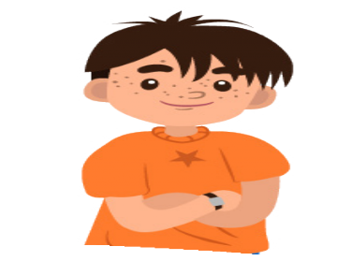
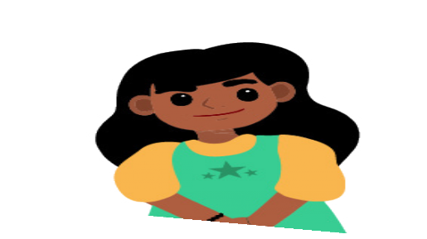






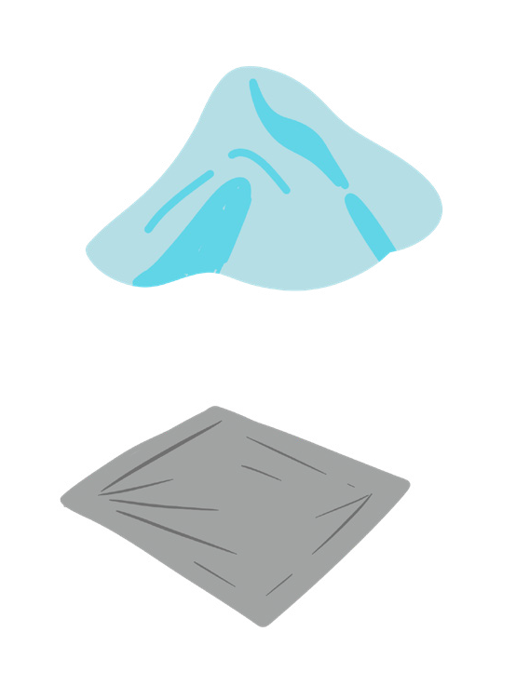

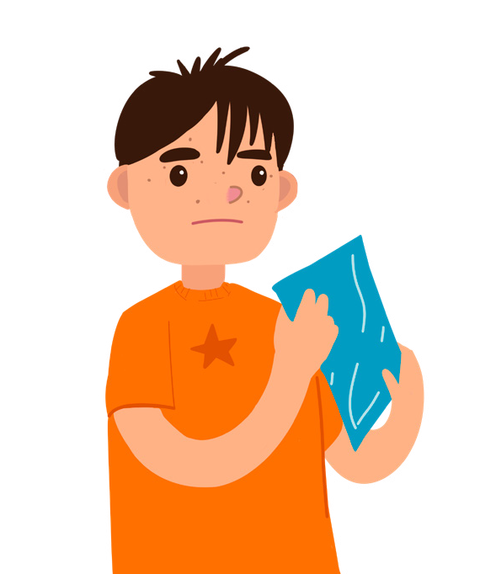



Sniffly Sneezes
Zeke
Joyti
Activity card:
Tara
Zeke grabs his hankie. Achoo! Achoo! Achoo!
He holds his hankie to his nose and sneezes three more times. “Oh dear, what a horrible sniffly sneeze!” he sighs, tucking his hankie into his pocket.
Now his nose is running! He needs to wipe it quickly. Zeke pulls out his hankie again and rubs his nose. This isn’t any fun.
There’s a knock at the door. It’s Tara. She’s brought Zeke a lolly to cheer him up.
Tara looks at Zeke, “Your nose is all red,” she says. “It must be sore.”
Zeke sighs again. “It’s my hankie. It doesn’t work very well. I wish I had a better one.”
“OK,” says Tara cheerfully. “I’m sure we can find something. I’ll go and ask my grandma, Joyti, to help us. She will have lots of things we could try. But how will we know which is best?”
Joyti says she thinks a hankie needs to be strong when it’s wet. Tara thinks a hankie needs to be soft on your nose, and Zeke thinks it needs to soak up water to keep your nose dry.
Have you ever had a cold? What kind of hankie did you use?
Your challenge
Zeke needs to know which hankie to use. He has lots of things to try. Can you help him?

Slide 4





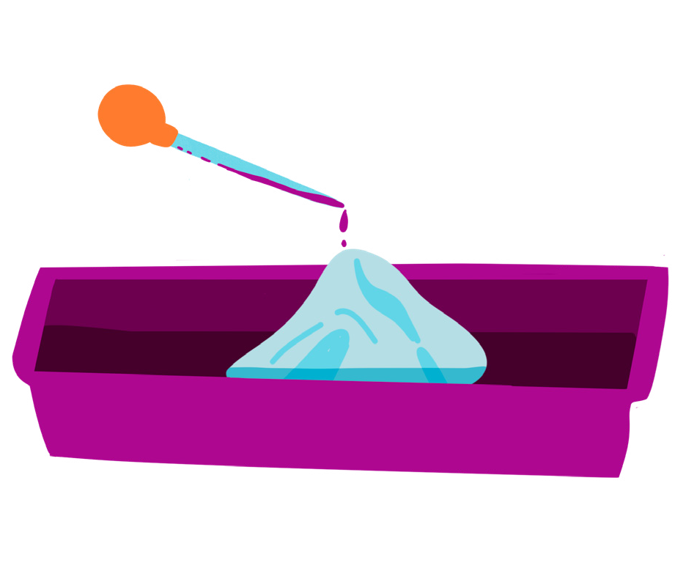





Discuss
Talk to your buddy about how you will find out which is the best material for a hankie.
Getting started
Get some different materials and a tray. Collect a beaker of coloured water.
How will you decide which material is best at soaking up the drips of water?
How much water will you put on each material?
Test your ideas
One at a time, put each material in the tray. Drip coloured water onto the material.
Does it soak up the water? Will it make a good hankie?
Share your ideas
Sort the materials into ones that worked well and ones that didn’t.
Can you put the materials in order from the one that soaks up the least water to the one that soaks up the most?
Take a photo of your order and compare it to other people’s.
Which material would make the best hankie?
Extra things to do
Can you do any other tests to decide which hankie is the best?
Find out why it might be better to have a hankie that you can throw away after you have used it.
British Science Association Registered Charity No. 212479 and SC039236

