Slide 1


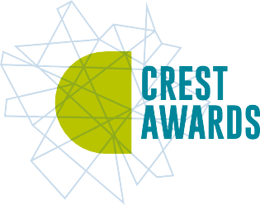










Useless Umbrella
Organiser’s card:
About the activity
This activity is designed to get children thinking about materials and their water resistance. You could run the activity with small groups, or with a whole class.
Kit list
Selection of fabrics and other materials e.g. plastic, sponge, foil, card and wood. Try to make sure some of the fabrics are waterproof. (Pieces from a broken umbrella or raincoat
would be good.)
Aunt Stella is going to a friend’s wedding. She is going to take a beautiful, big, rainbow umbrella with her in case it rains. Cosmic has rushed into the garden with the umbrella to try it out. It’s raining. Oh no! The umbrella is leaking. Cosmic is getting very wet. How can they fix the umbrella for Aunt Stella?
Through this activity you will support your group to:
Pipettes
Design an experiment to test how waterproof different
materials are.
Water coloured with food dye or a drop of paint
Carry out their experiment and observe what happens.
Beakers
Decide on the best material for an umbrella and share their ideas.
Plastic trays
Paper towels (including a few
extra to wipe up any spills)
What to do
Paper, pencils and pens for creating pictures (optional)
Introduce the activity by reading the story on the accompanying slides or activity card. Get the children to talk about the questions and the opinions of Cosmic, Seren and Aunt Stella.
Provide the children with a selection of different pieces of fabric and other materials to test, some examples are in the kit list.
Talk through how they might find out if the fabrics are waterproof. Encourage them to explore their own ideas.

Slide 2











4. When they have finished they can sort the materials and talk about which ones were waterproof. The children could design an umbrella and evaluate which designs will work and why. They might like to draw a picture of Aunt Stella’s umbrella and stick on a piece of the material they would choose to fix it.
Key words
Wet
Dry
Materials
Waterproof
Liquids
5. There are extra things to do on the activity card for children who have finished or who want to do more finding out at home.
Things to think about
There may be more than one property to consider when designing and making objects such as umbrellas, e.g. what it looks like, if the material is flexible, as well as if it is waterproof.
Watch out!
An umbrella needs to be waterproof but a waterproof material that does not fold will not be any use at all. If no-one likes how the umbrella looks, or the material is too heavy, then it will not be used. It is helpful to provide materials such as plastic, foil and wood so that children can explore and discuss their suitability.
Mop up spills to avoid a
slippery floor.
Warn children not to squirt coloured water at each other.
Water will sometimes sit on top of some fabrics but when they are touched the water goes through. Thick, soft materials, such as wool and sponge, can get waterlogged even if very little water drips through.
Ensure children do not taste or put the liquid or materials used in this activity near their mouths. If using food colouring, this can stain children’s fingers.
In science, the word material is used to describe the substance from which anything is made. Fabric is one type of material.
Metal, plastic and glass are also materials.
Take it further
Dripping coloured water onto the material, placed on top of a paper towel, can make it easier to judge how much water has come through. Children can measure the width of the watermark.
You could put the fabric over a container and see how much drips through in a certain amount of time and/or when touched.
British Science Association Registered Charity No. 212479 and SC039236

Slide 3
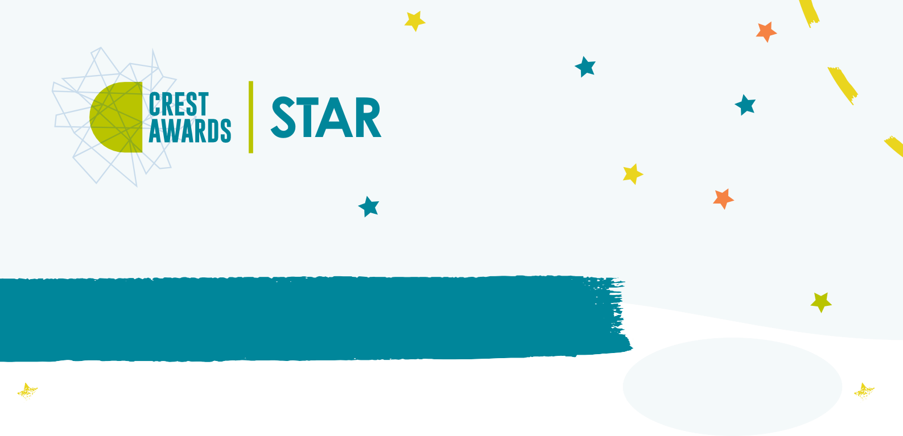
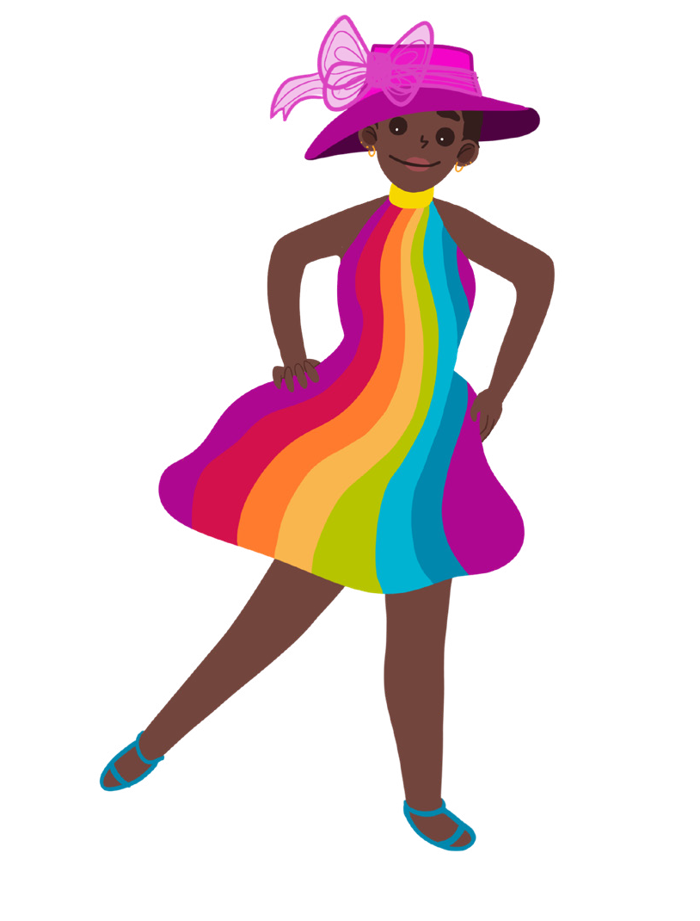



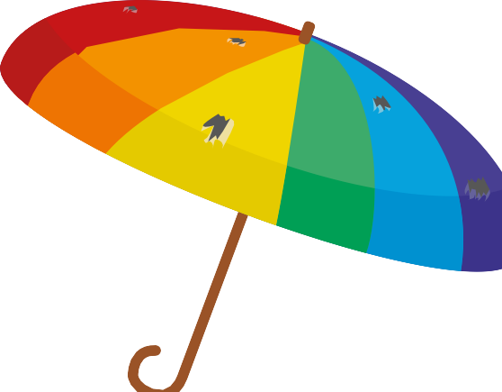





Useless Umbrella
Aunt Stella
Activity card:
Aunt Stella is very excited, she has been invited to a friend’s wedding.
“Have you got a new dress,” Seren asks, “and a new hat?” Aunt Stella goes to her wardrobe and pulls out a rainbow coloured dress and a bright purple hat.
“You are going to look fantastic,” says Cosmic. “Do you have an umbrella too, in case it rains?” Aunt Stella nods and goes to the cupboard and pulls out a huge, rainbow coloured umbrella to match her dress. “Here it is,” she says.
“It’s enormous! Can we try it Aunt Stella?” shouts Cosmic, as he rushes outside to open the umbrella.
But it’s raining outside and no sooner has Cosmic opened the umbrella than drip, drip, drip, rain is tumbling onto his head through the umbrella. The umbrella is full of holes! The umbrella is useless. “What am I going to do?” says Aunt Stella. “I don’t have another one.”
“Don’t worry Aunt Stella, I am sure we can fix it for you,” says Cosmic. “We just need to find something waterproof,” suggests Seren.
Cosmic and Seren need to find something to fix Aunt Stella’s umbrella.
Cosmic thinks they need a sponge to make it waterproof Seren thinks they need thick fabric to fix the umbrella Aunt Stella thinks they need brightly coloured, thin
fabric to fix the umbrella.
What do you think?

Slide 4


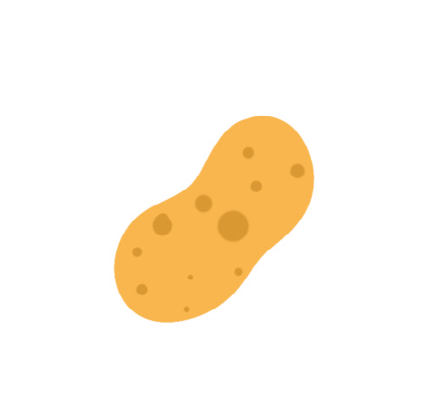



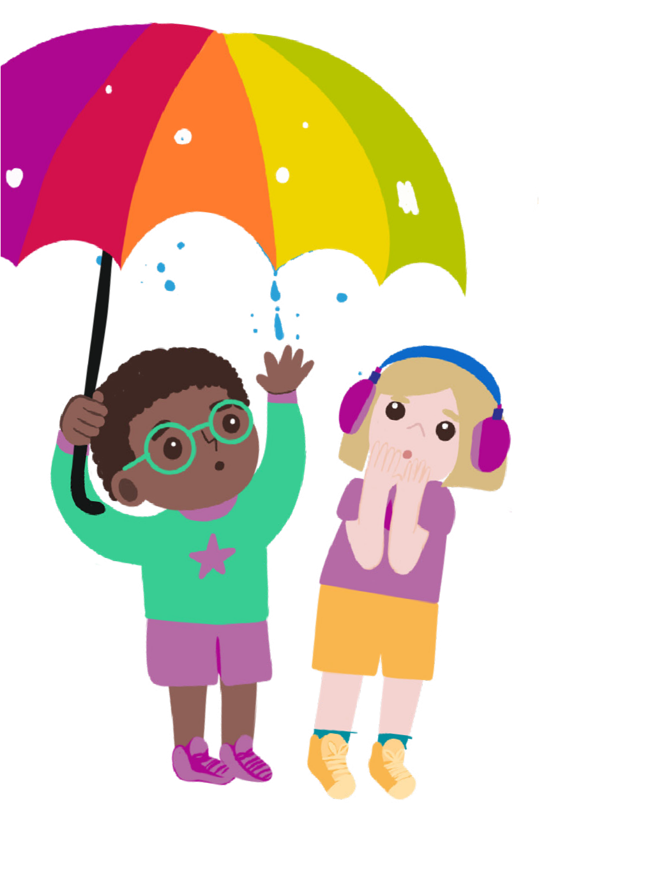






Your challenge
Think about what umbrellas are made from and how they stop you getting wet.
Discuss
Can you find the best material to fix Aunt Stella’s umbrella?
Talk to your buddy about which material you think will be the best for an umbrella. How do you think you can find out?
Getting started
Collect some different materials and a beaker of coloured water.
You will also need a plastic tray and some dry paper towels.
Which materials do you think will let the water through?
Test your ideas
One at a time, put each material on a paper towel, on the plastic tray.
Cosmic
Seren
Share your ideas
Put one drop of coloured water on each material. Does any water come through onto the paper towel?
Can you think of any other ways to find
out which materials are waterproof?
You could use a hoop to sort the materials into ones that are waterproof and ones that are not. Would all the waterproof materials be good for fixing the umbrella? Why?
Extra things to do
Draw Aunt Stella’s umbrella and stick pieces of the best materials on the picture.
Do you think Aunt Stella will like the umbrella?
Make a list of things that you might want to protect from the rain.
What about a rabbit in the garden, your books on the way to the library or shopping on the way home? Can you think of ways to keep them dry?
British Science Association Registered Charity No. 212479 and SC039236

